Slide 1
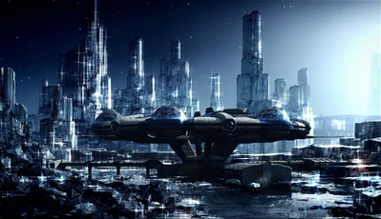
The Plausible
(and Implausible!)
Worlds of
@aussiastronomer
Dr Jessie Christiansen
NASA Exoplanet Science Institute

Slide 2
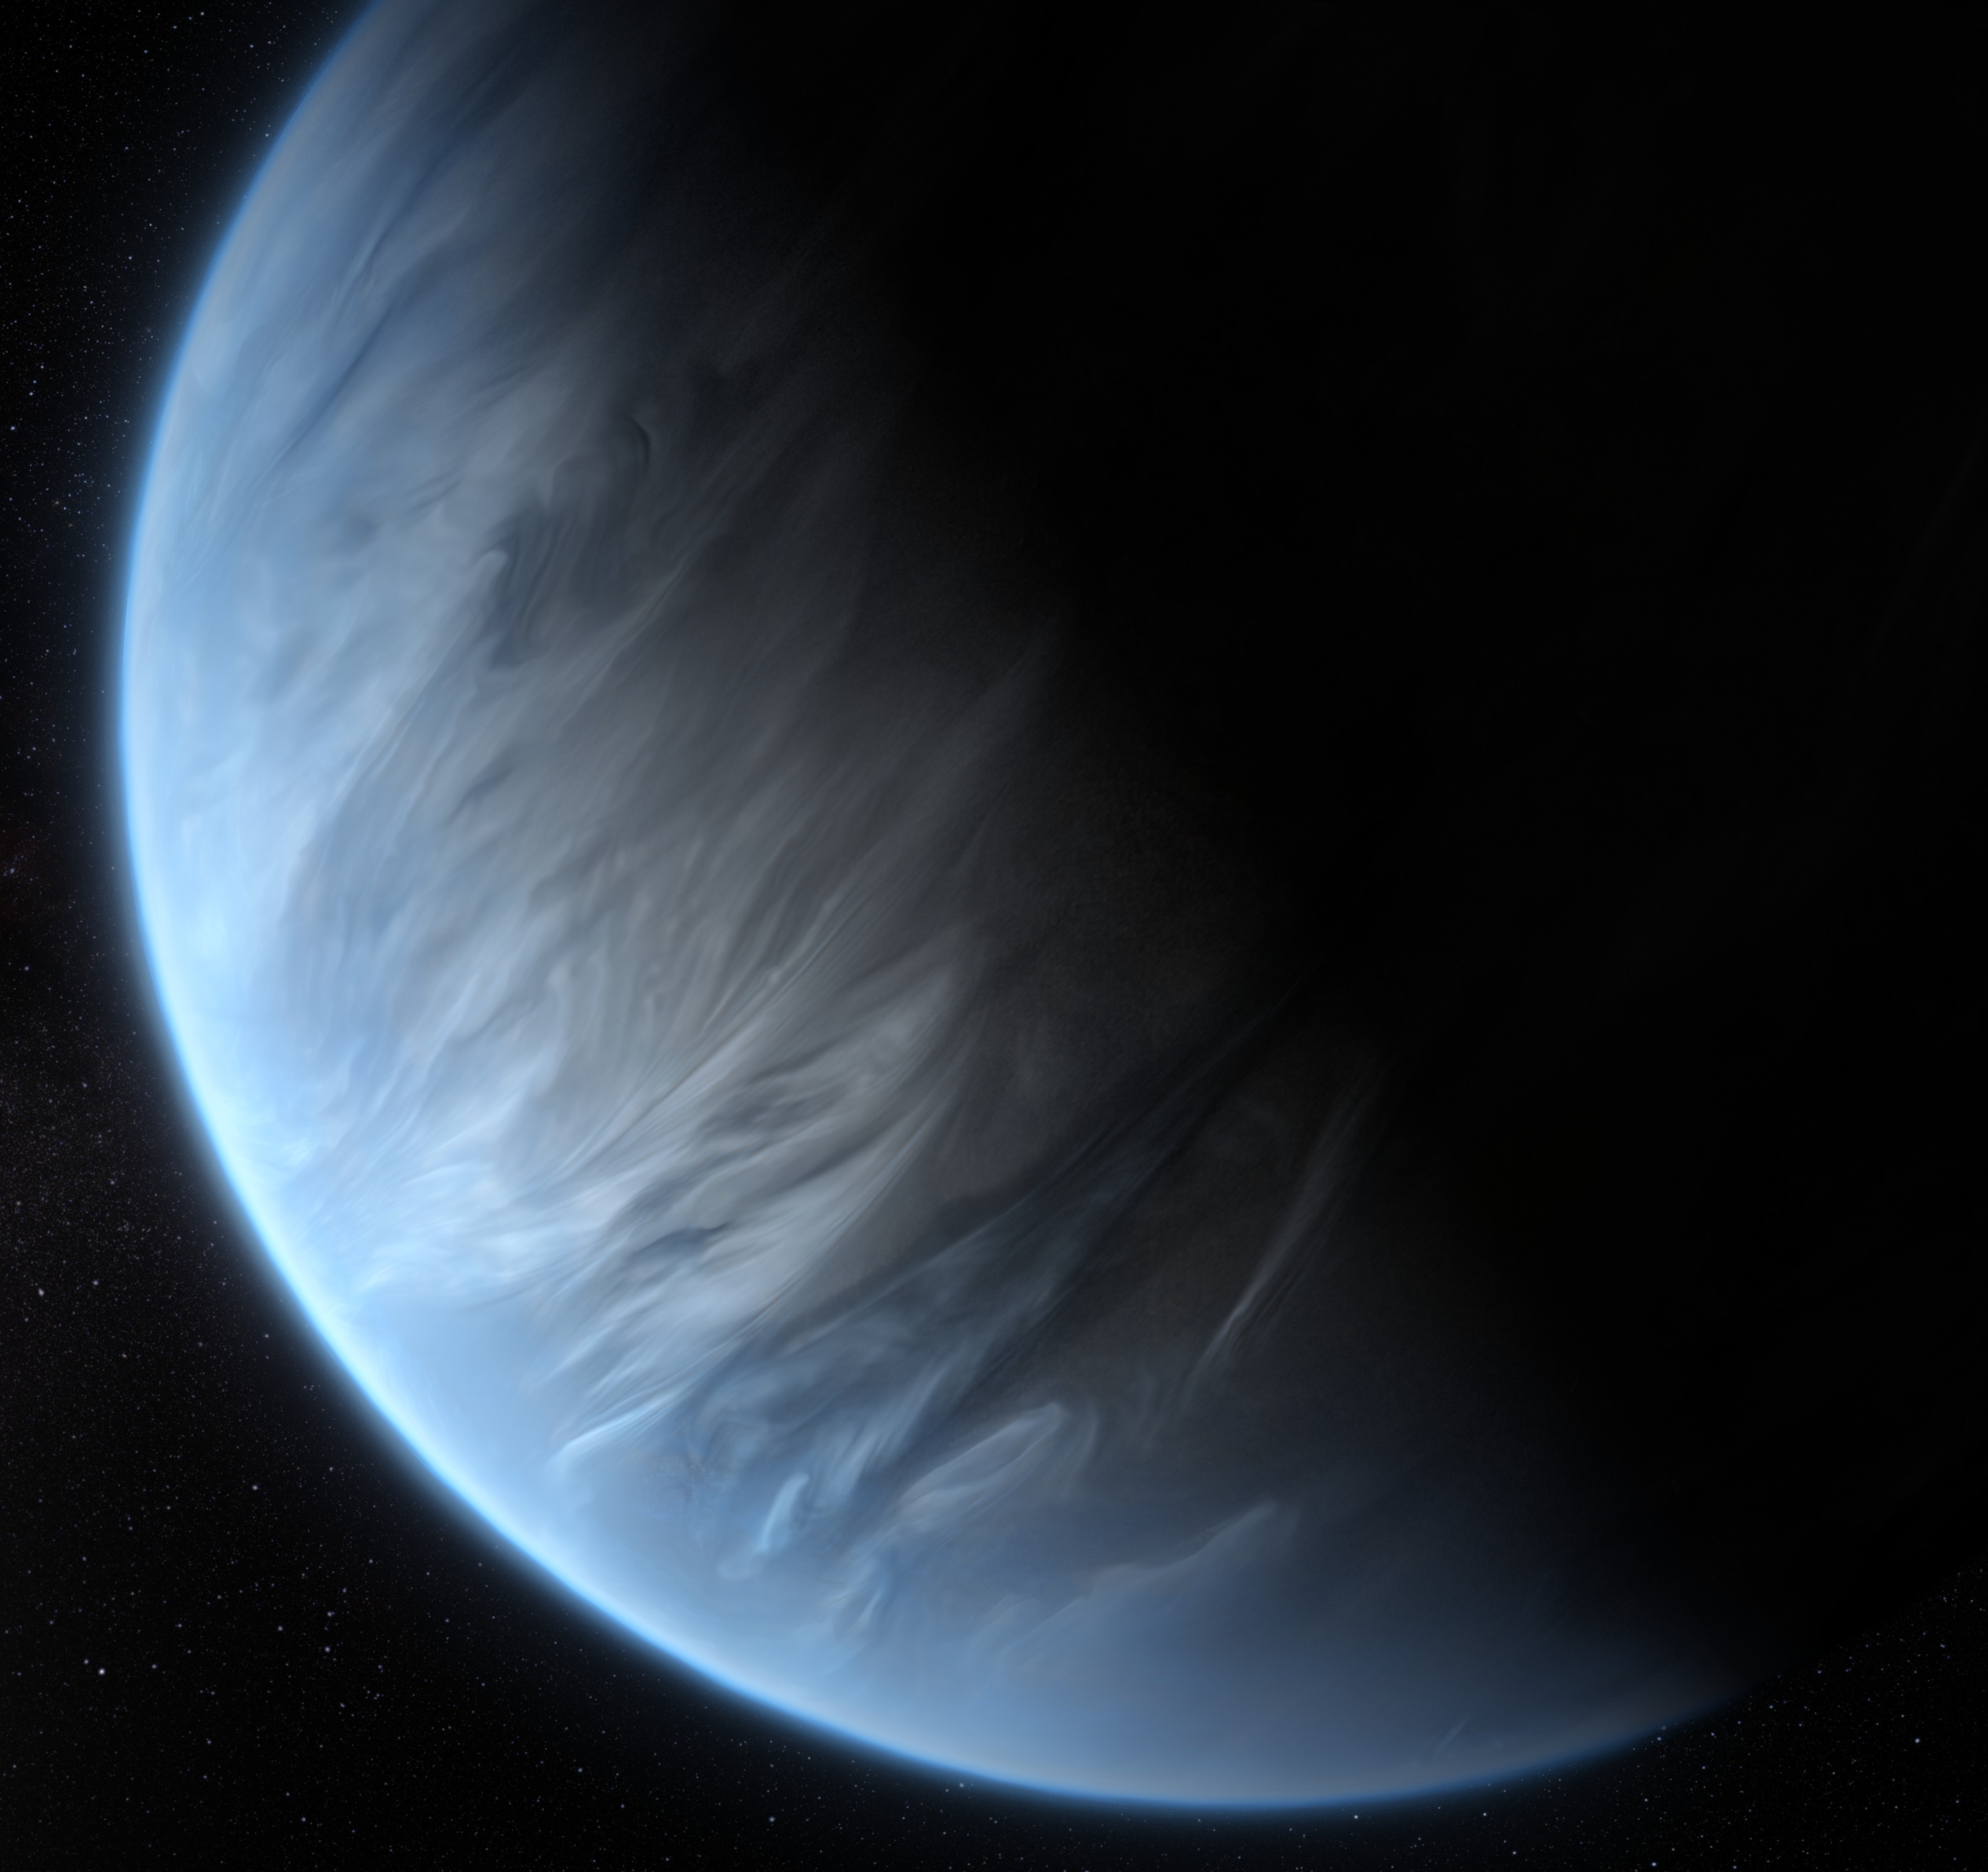

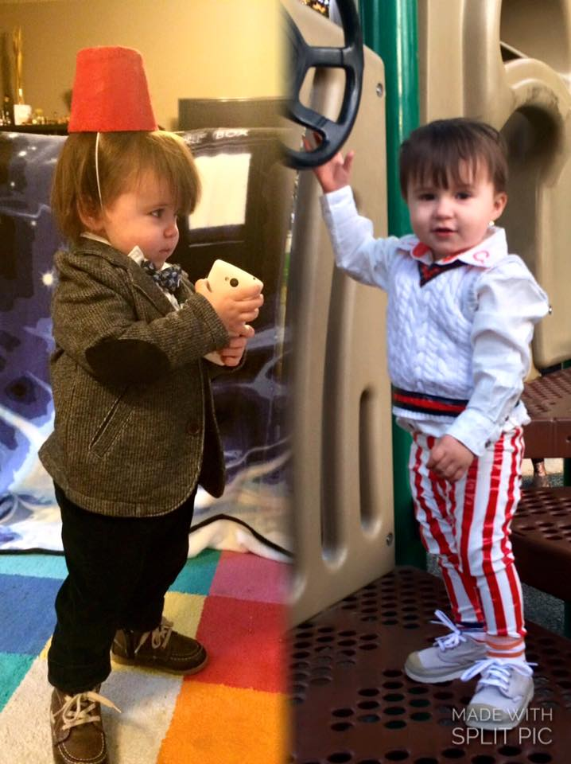

Slide 3
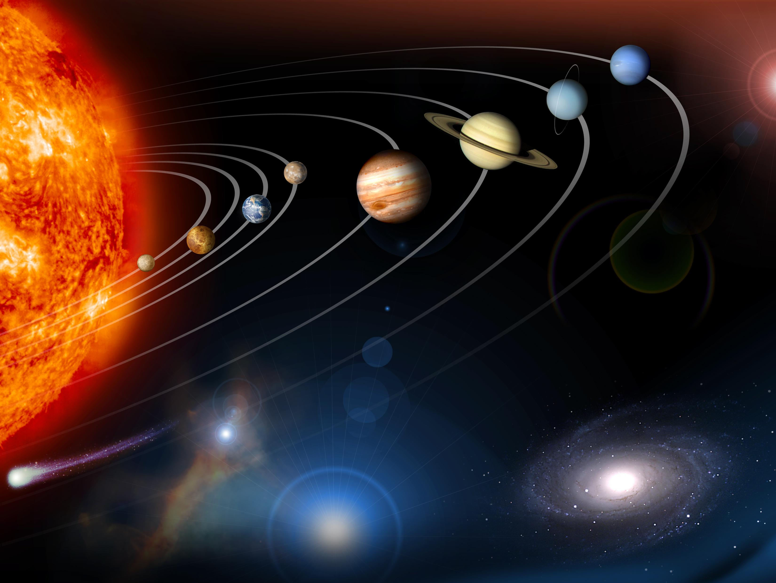
STAR – 1
PLANETS – 8
Dwarf planets – Pluto, Sedna, Makemake, Eris, Ceres,+++
Minor planets – Dwarf planets, asteroids, trojans, centaurs, Kuiper belt objects, trans-Neptunian objects… 710,000!!
Exoplanets?

Slide 4
From scifi → science
600BC: Greek philosophers discuss the infinity or singularity of Earth as a purely abstract idea – Plato and Aristotle argue for the uniqueness of Earth
600BC: Greek philosophers discuss the infinity or singularity of Earth as a purely abstract idea – Plato and Aristotle argue for the uniqueness of Earth
~1300: Dante’s Paradis explores concentric spheres around the Earth, including Mercury, Venus, Mars, Jupiter and Saturn
1592: “There are countless suns and countless earths all rotating round their suns in exactly the same way as the seven planets of our system.” – Giordano Bruno
1592: “There are countless suns and countless earths all rotating round their suns in exactly the same way as the seven planets of our system.” – Giordano Bruno
1700s: The Moon! (many works of literature)
1800s: Mars! (many works of literature)
1952: Otto Struve suggests a technique to observe how fast stars are moving to find the ones being nudged by planets orbiting them
1952: Otto Struve suggests a technique to observe how fast stars are moving to find the ones being nudged by planets orbiting them
1956: Forbidden Planet (film)
1963: Doctor Who (TV)
1995: The first planet orbiting a sunlike star was found using the method Struve proposed!

Slide 5
The planets of the Whoniverse
OTHER
SPACE
UNINHABITABLE
EARTH-ISH…
EARTH
EARTH-LIKE
(Thanks to Dr JJ Eldridge @astro_jje)

Slide 6
The planets of our universe
Bigger →
(Mondas/New Earth Parallel Earth)
Further away →

Slide 7
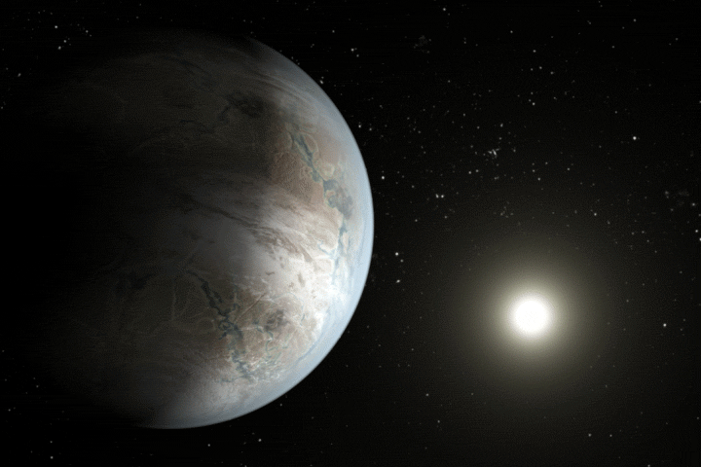
Earth-like planets…
Maybe?

Slide 8
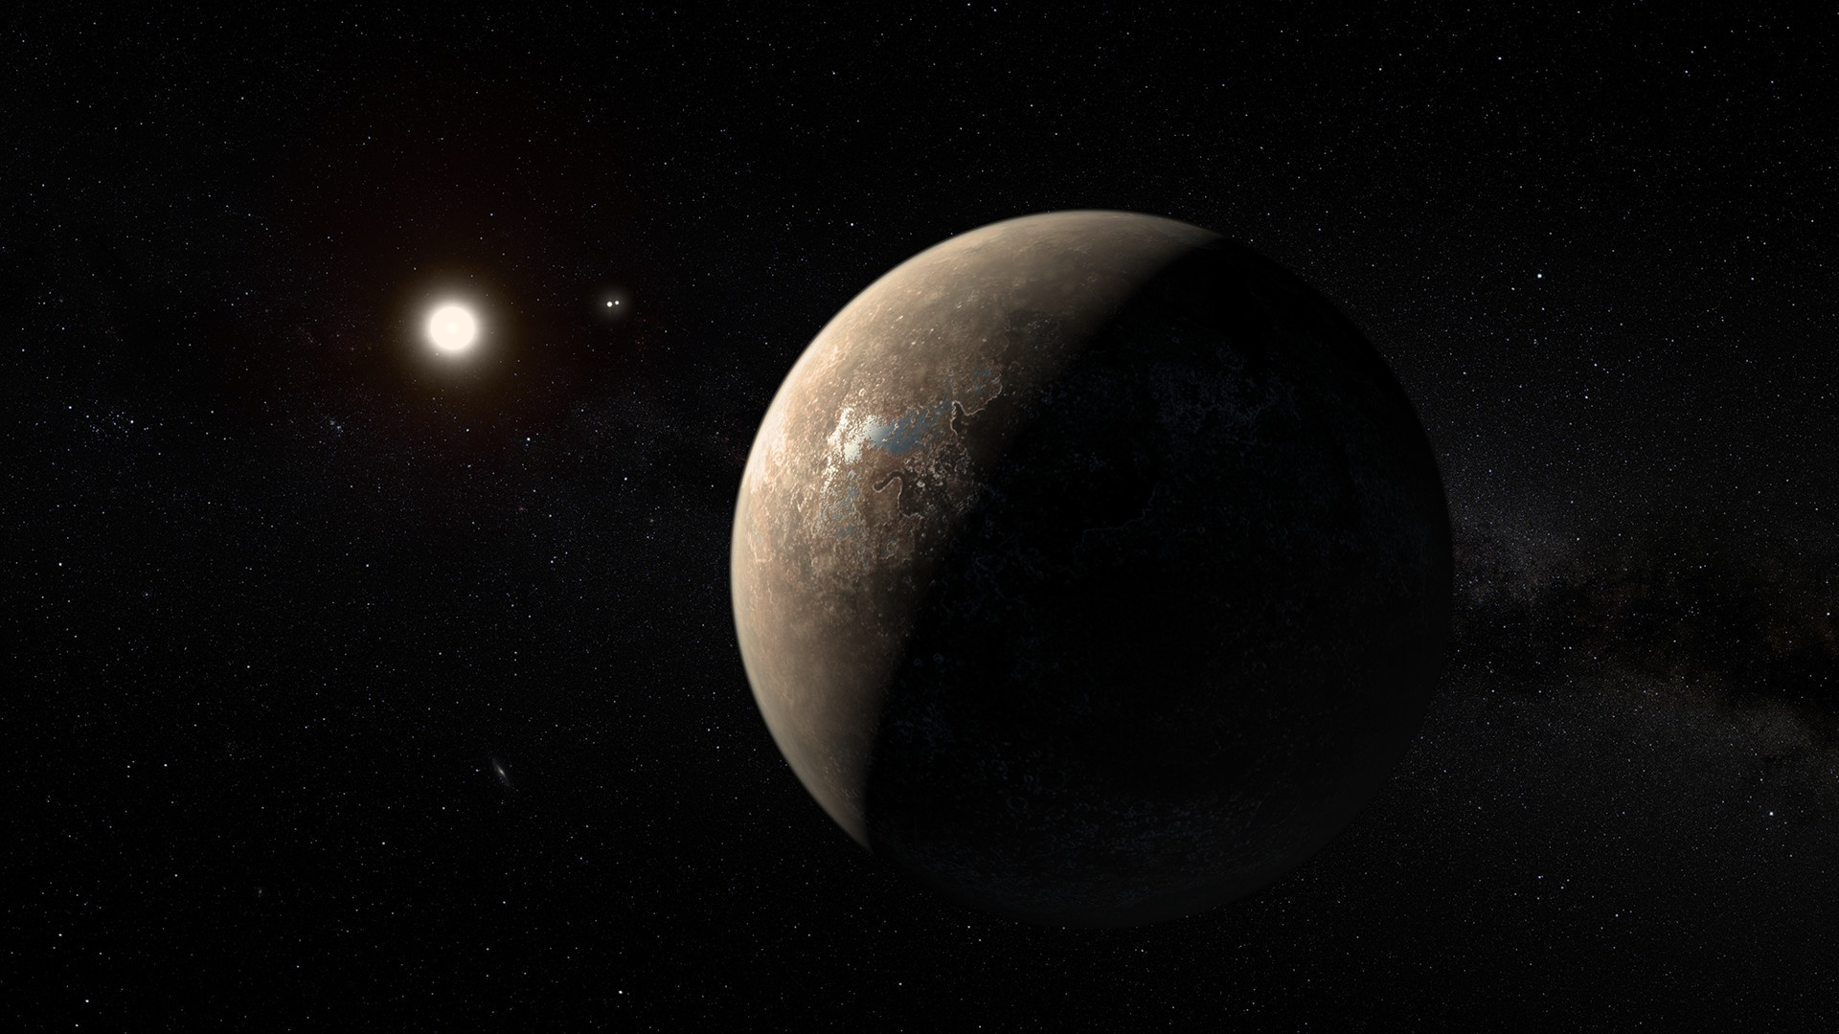
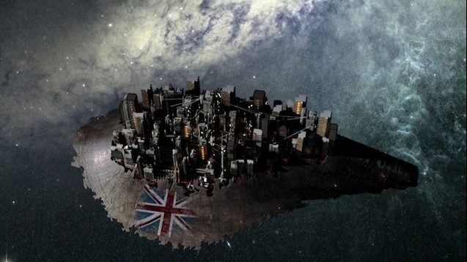
Earth-like planets…
Maybe?

Slide 9
proxima Centauri b
7
TRAPPIST-1e
Kepler-442 b
TRAPPIST-1f
GJ 667 C c
TRAPPIST-1g
Kepler-186 f
0 (so far…)

Slide 10
So what DID we find?
Hot Jupiters

Slide 11
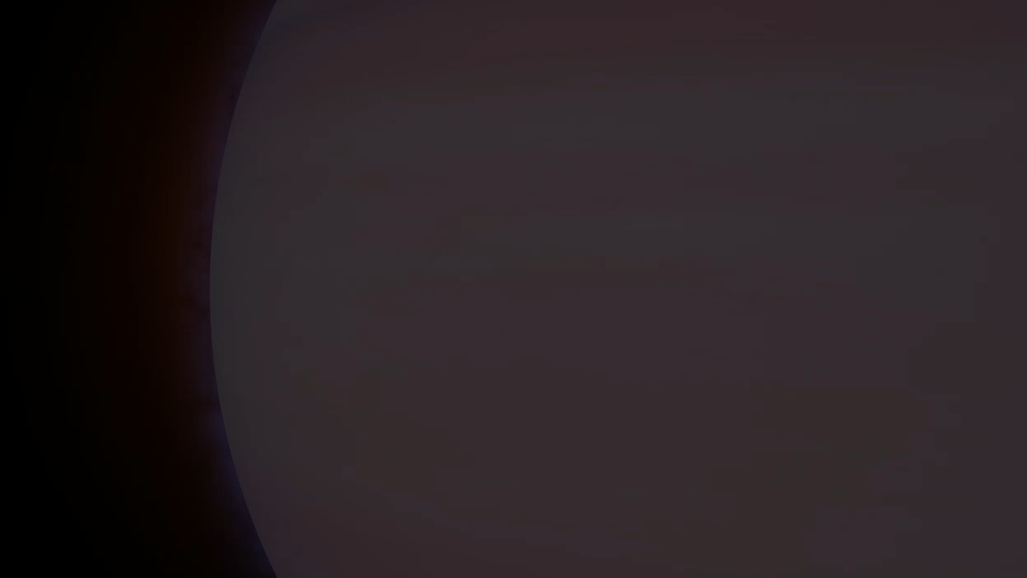
Hot Jupiters

Slide 12
So what DID we find?
Hot Jupiters
Lava Worlds

Slide 13
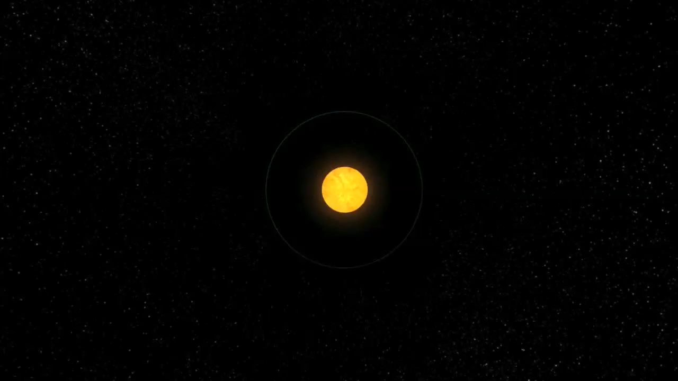
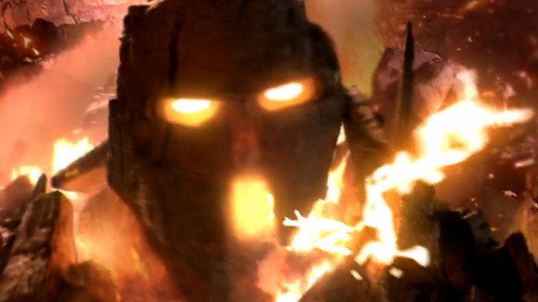
Lava worlds
PYROVILLIA

Slide 14
So what DID we find?
Hot Jupiters
Ocean Worlds and Ice Giants
????????
Lava Worlds
Rocky Planets

Slide 15
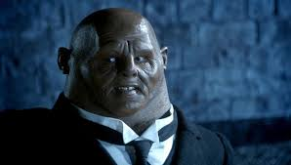


Super-Earths/
Neptinis
SONTAR
Notes:
Super-Earths – high gravity

Slide 16
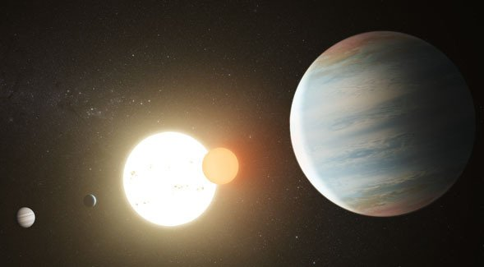
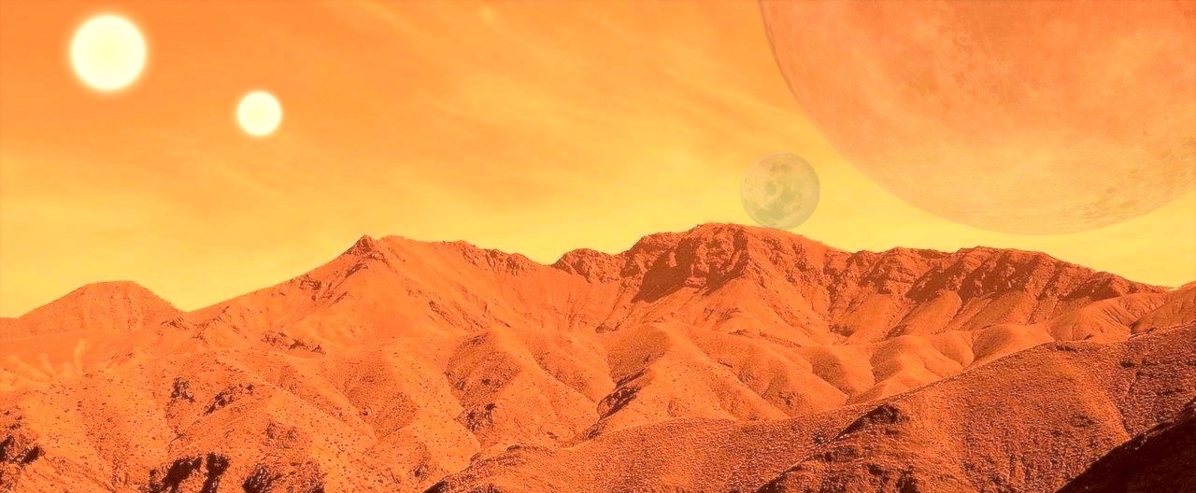
Gallifrey
✓
Rocky planet
Red planet
Orbiting a double star
PLAUSIBLE
✓
✓
NASA-JPL/Caltech

Slide 17
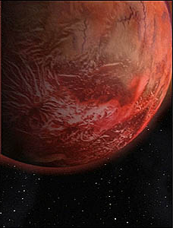
Skaro
✓
Rocky planet
Continents and oceans
12th planet in the system
Three moons (one artificial)
PLAUSIBLE
✓
✓
✓

Slide 18
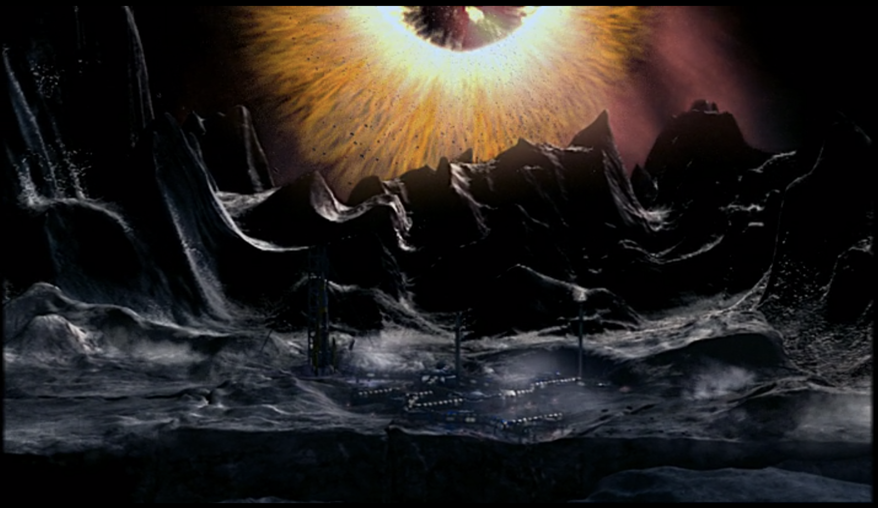
Krop Tor
✓
Rocky planet
Orbiting a black hole
… so close that a gravity beam is needed to stop it falling in?
IMPLAUSIBLE
✓
✕

Slide 19
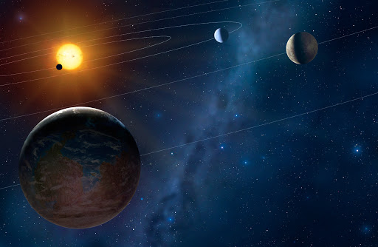
Ogros
✓
Swampy planet
Amino acids and proteins
Silicon-based lifeforms
Orbiting tau Ceti
PLAUSIBLE
✓
?
✓
Notes:
Episode aired 1978, tau ceti planets discovered 2017!

Slide 20
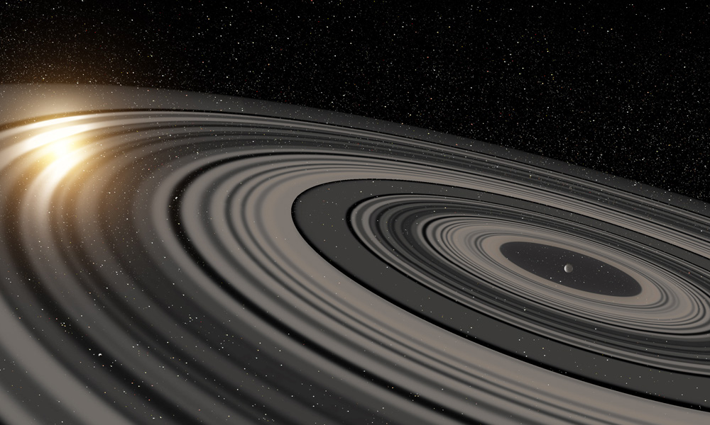
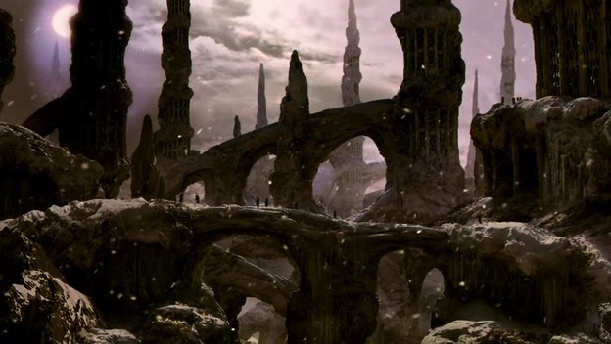
Oodsphere
✓
Icy, rocky moon
Ringed Planet
PLAUSIBLE
✓
1SWASP J1407b
Notes:
Episode aired 1978, tau ceti planets discovered 2017!

Slide 21
Wirrn Homeworld
✓
Produces giant insects
In Andromeda Galaxy
PLAUSIBLE
✓
Notes:
Episode aired 1978, tau ceti planets discovered 2017!

Slide 22
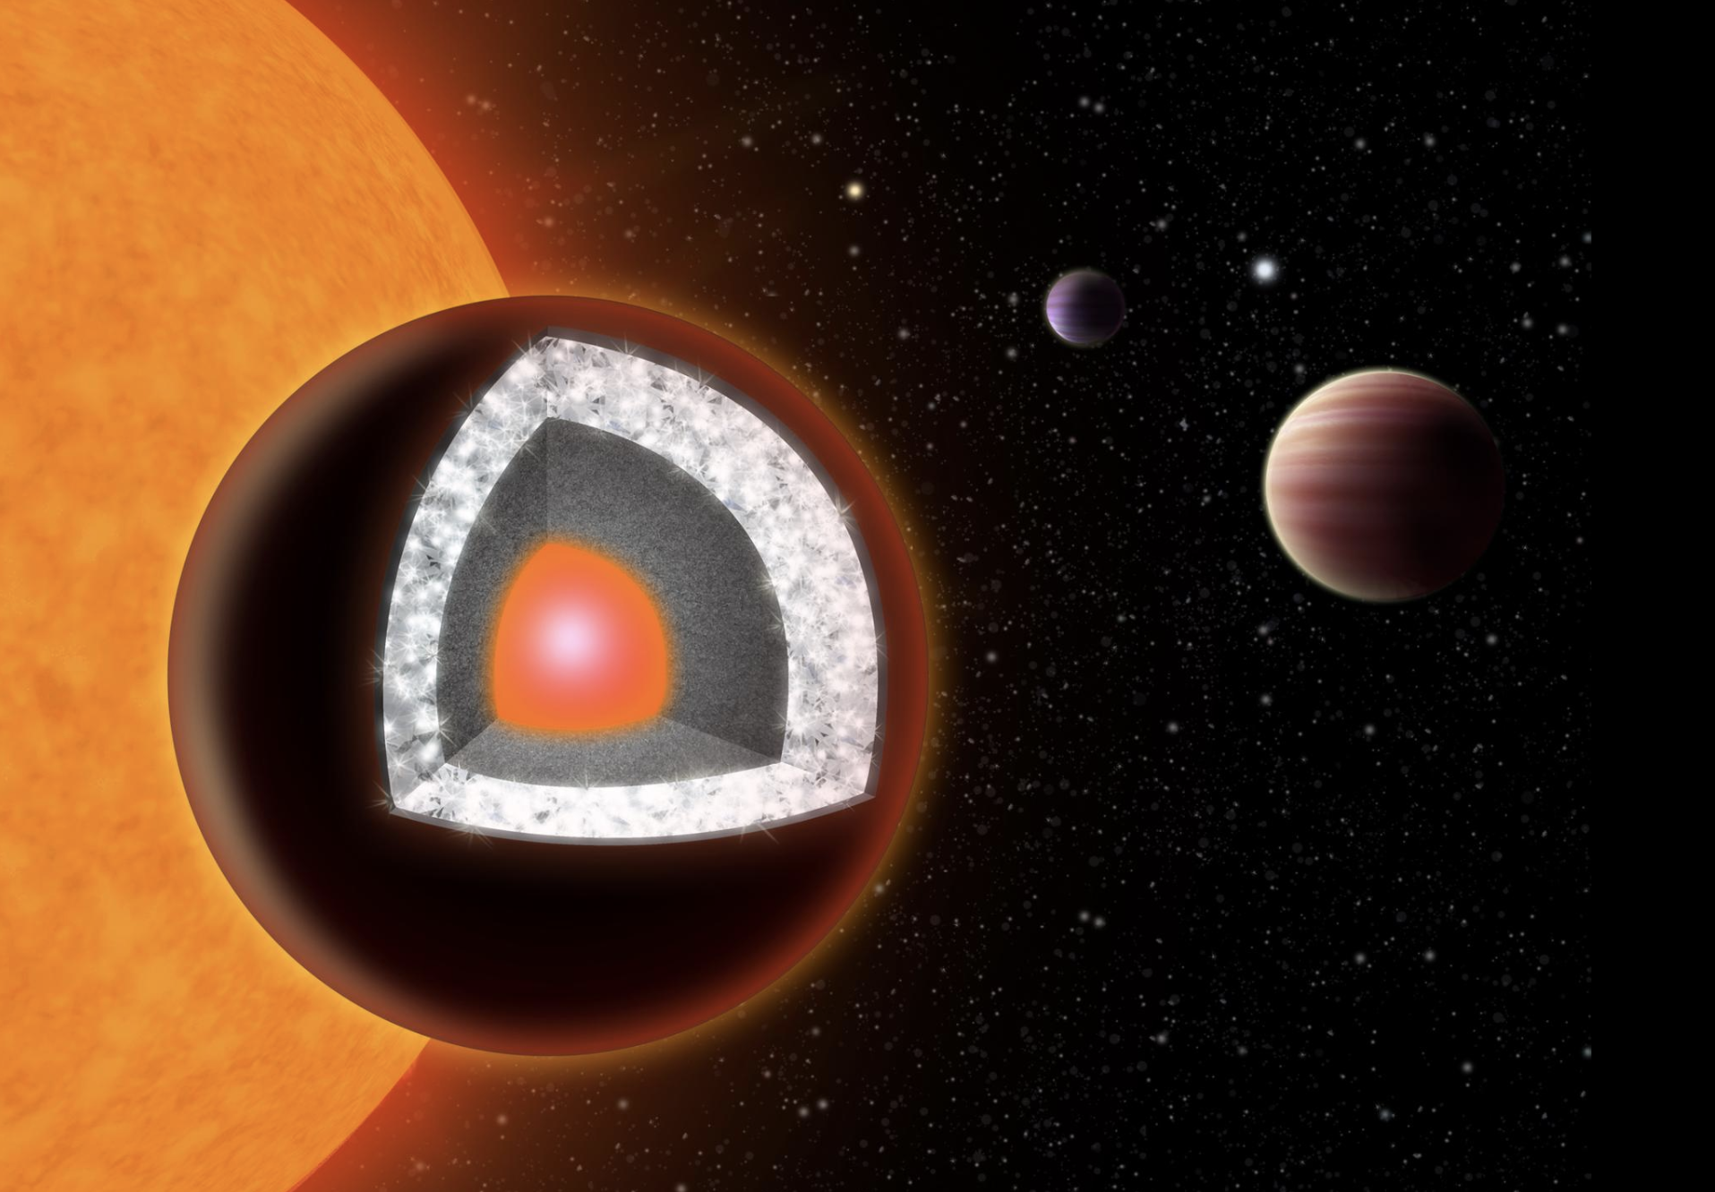
Midnight
✓
Crystal planet
“X-tonic” radiation
PLAUSIBLE
✓
55 Cancri e

Slide 23
Ask me about…
Your favourite Doctor Who planet!
NASA’s planet-hunting missions!
The weirdest planets we’ve discovered!
How do we find these planets anyway?!

