Slide 1
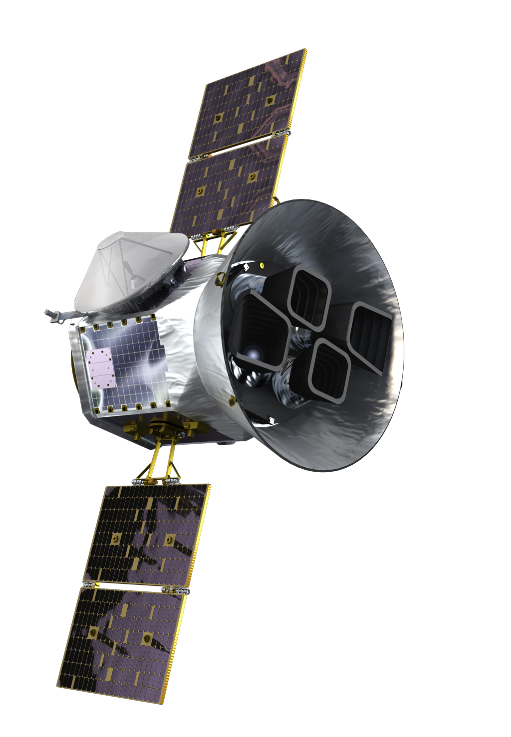
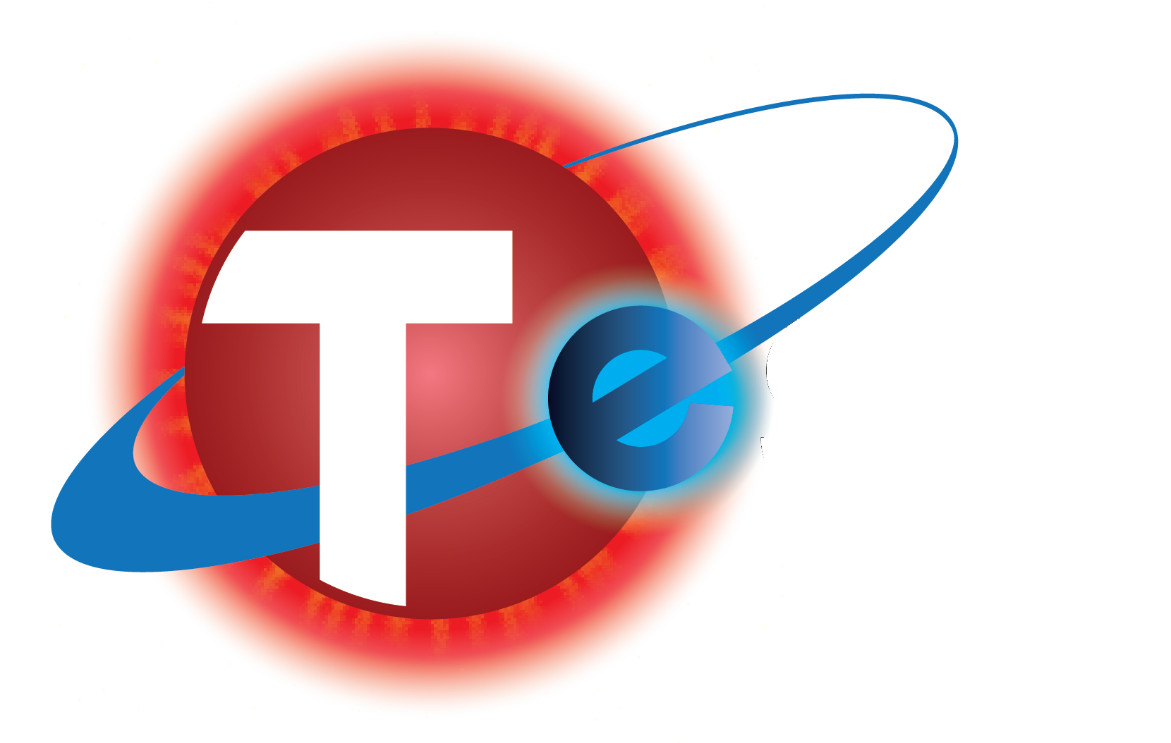
A Whole New World Mission
With thanks and/or apologies to
Robin Williams
acapellascience
George Ricker
Your ears
Jessie Christiansen
#ipacgiss @aussiastronomer

Slide 2
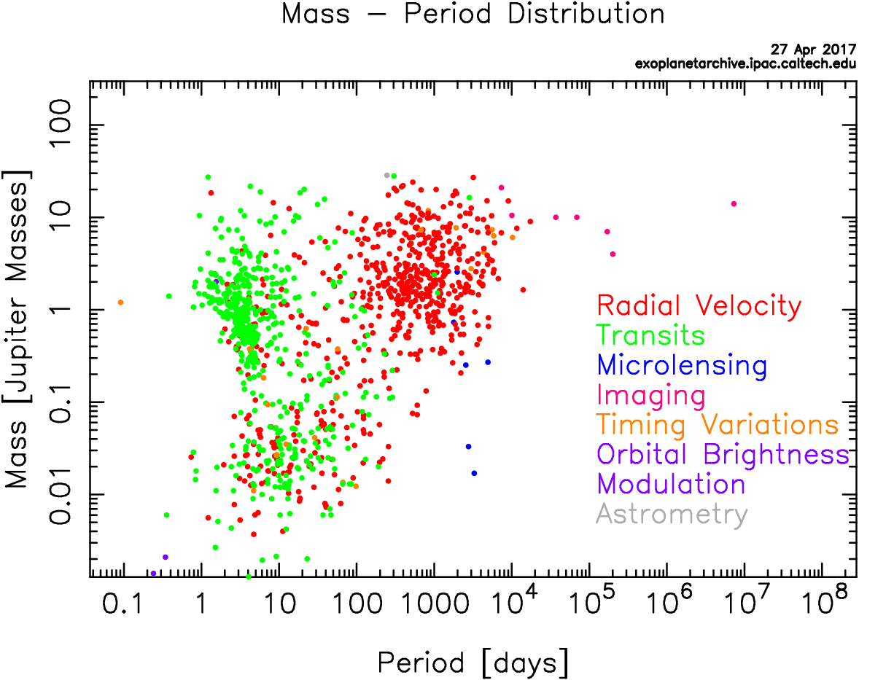
Well, plotting Doppler shifts is glacial-pace
And that astrometry never prevails
But baby you're in luck cause, up in space
You’ll have a planet-finder never fails!

Slide 3
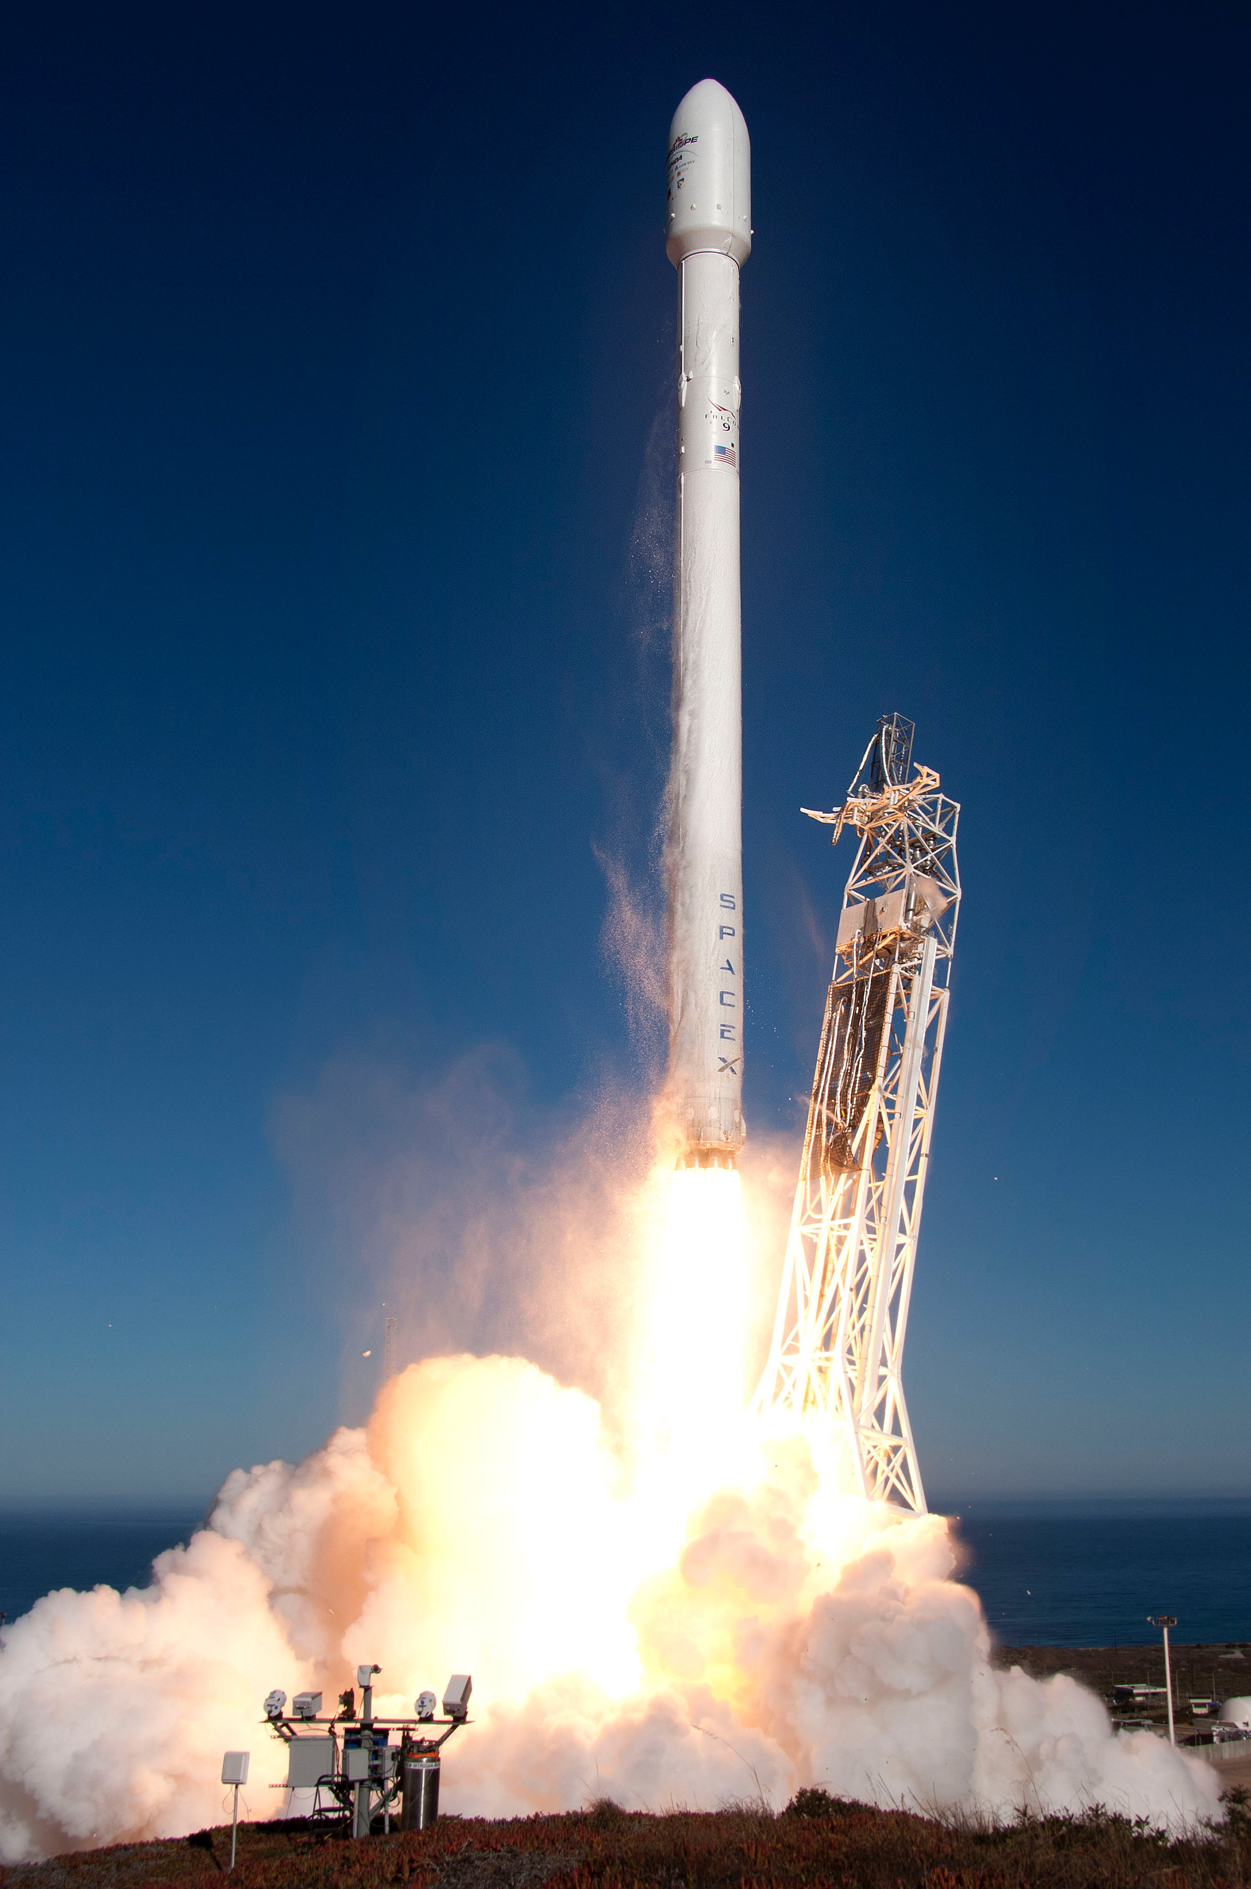
(March 2018)
You got the power of precision now
You’ll have a view without an atmosphere
So no more nights spent locked up in your tower
All you gotta do is wait right here
And I say…

Slide 4
Oh TESS the planet-searcher Got a dip, no 2, no 3! We just measure brightness Plot it out and that's transiting photometry
1!
2!
3!
Christiansen+, accepted

Slide 5
It’s in a lunar orbit, full of eccentricity
We grab the data every 14 days
Gathered while it’s at apogee!
TESS Orbit Animation

Slide 6
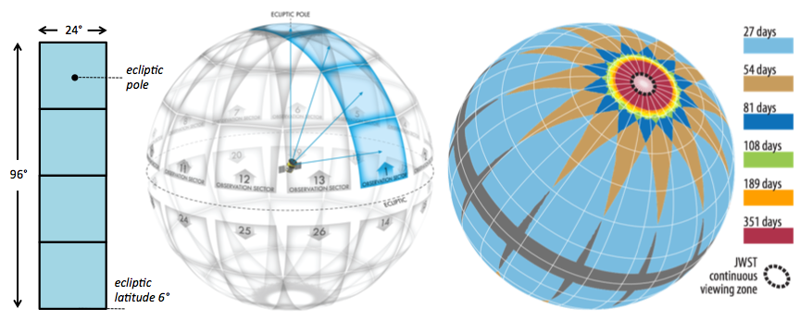
Yes sir, we’ve gotta lotta cameras
Scanning all of the degrees!
Including a continuous viewing zone
Synched up with JWST
FOV Animation

Slide 7
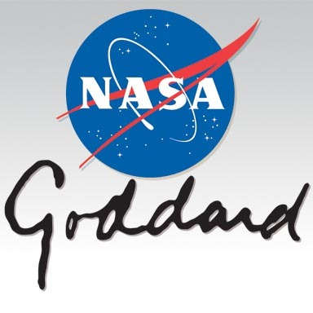
Oh TESS the planet-searcher
Led out of MIT
Throw in the MAST, CfA and Ames
And don’t forget GSFC…
(SOC/POC)
(TSO)
(GI Program)
(SPOC)
(ExoFOP-TESS)

Slide 8
(The karaoke version says ‘SCAT’)
(I’m not doing that)

Slide 9
When your stars do this
And your curves displace
Then your star's got this
Transiting its face

Slide 10
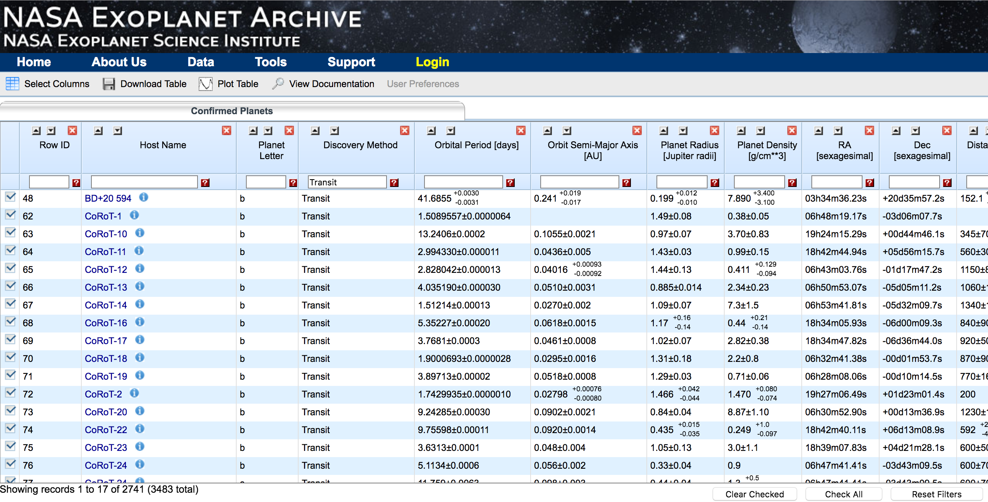
Then you hit compute! And lookie here You get good diameter data from that dip And orbit distance from the length of year…

Slide 11
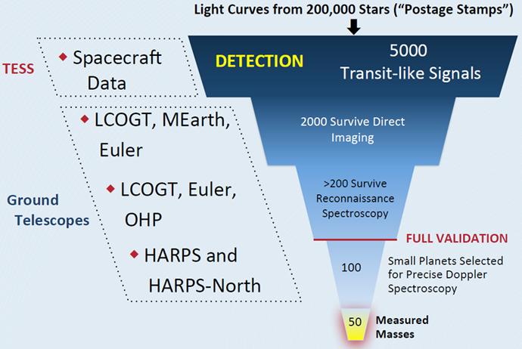
Well now we need this tale supported by
A ground observer with a good Échelle
We got observers lining up to help
If we need ‘em only time will tell…
ExoFOP-TESS TFOP Community

Slide 12
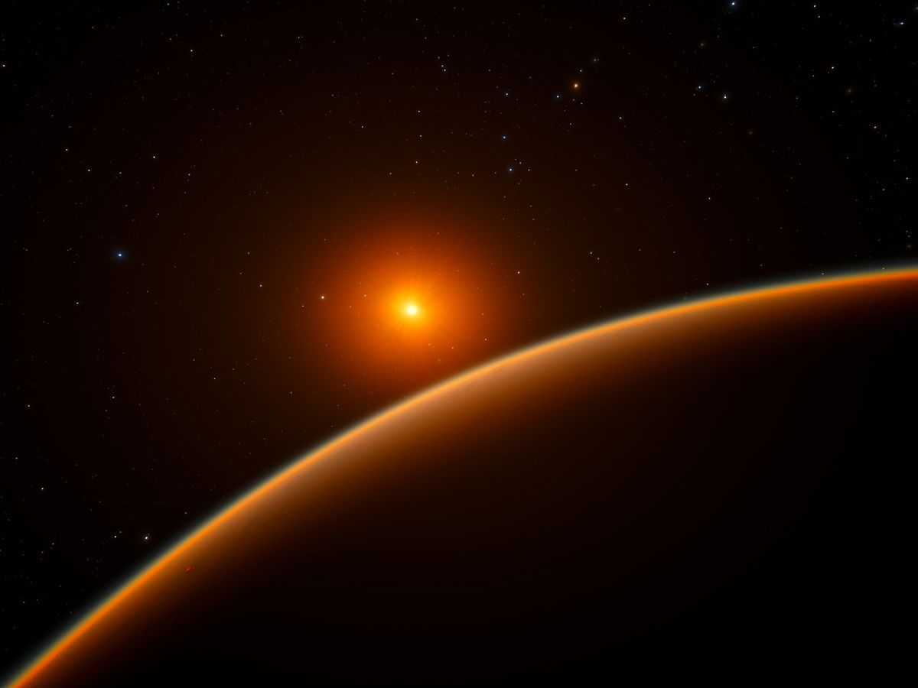
But let's take em all, plot em out
And find out if we're really alone
Is there a rocky world we've found no doubt
That orbits in the habitable zone, like home?
ESO/SpaceEngine.org

Slide 13
Oh TESS the planet searcher
Got some planets yet to see
Part of a throng
40 billion strong

Slide 14
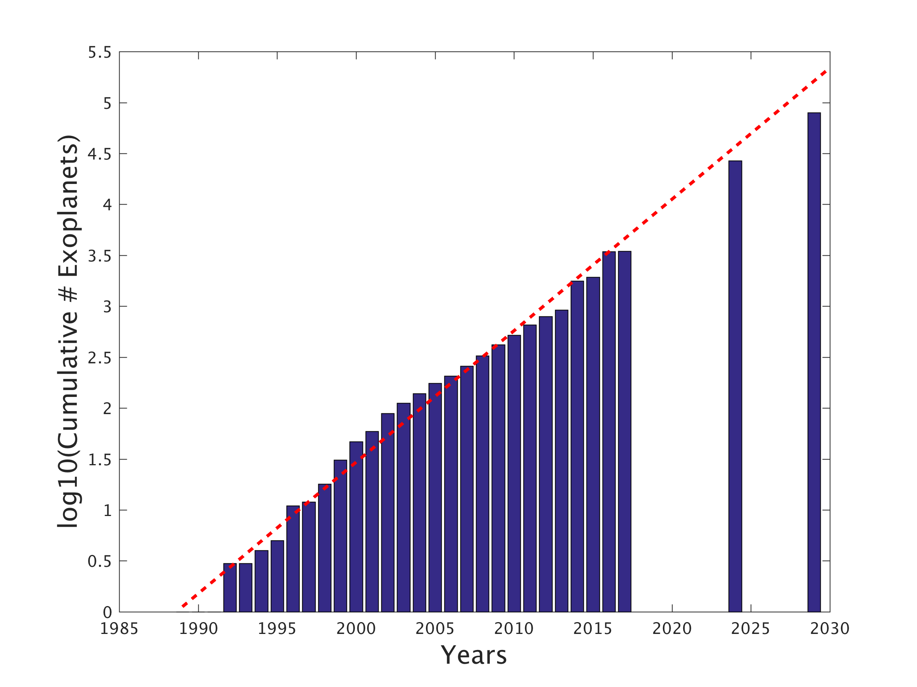
There ain't never been a field clever as the field
There ain't never been a field better than the field
They call
Exoplanetology!
(…Exoplanetology!)
PLATO
TESS
MAMAJEK’S LAW

