Slide 1
K2, TESS and the future
K2/TESS Special Session
#aas229, January 4 2017
Jessie Christiansen
Caltech/IPAC-NExScI

Slide 2
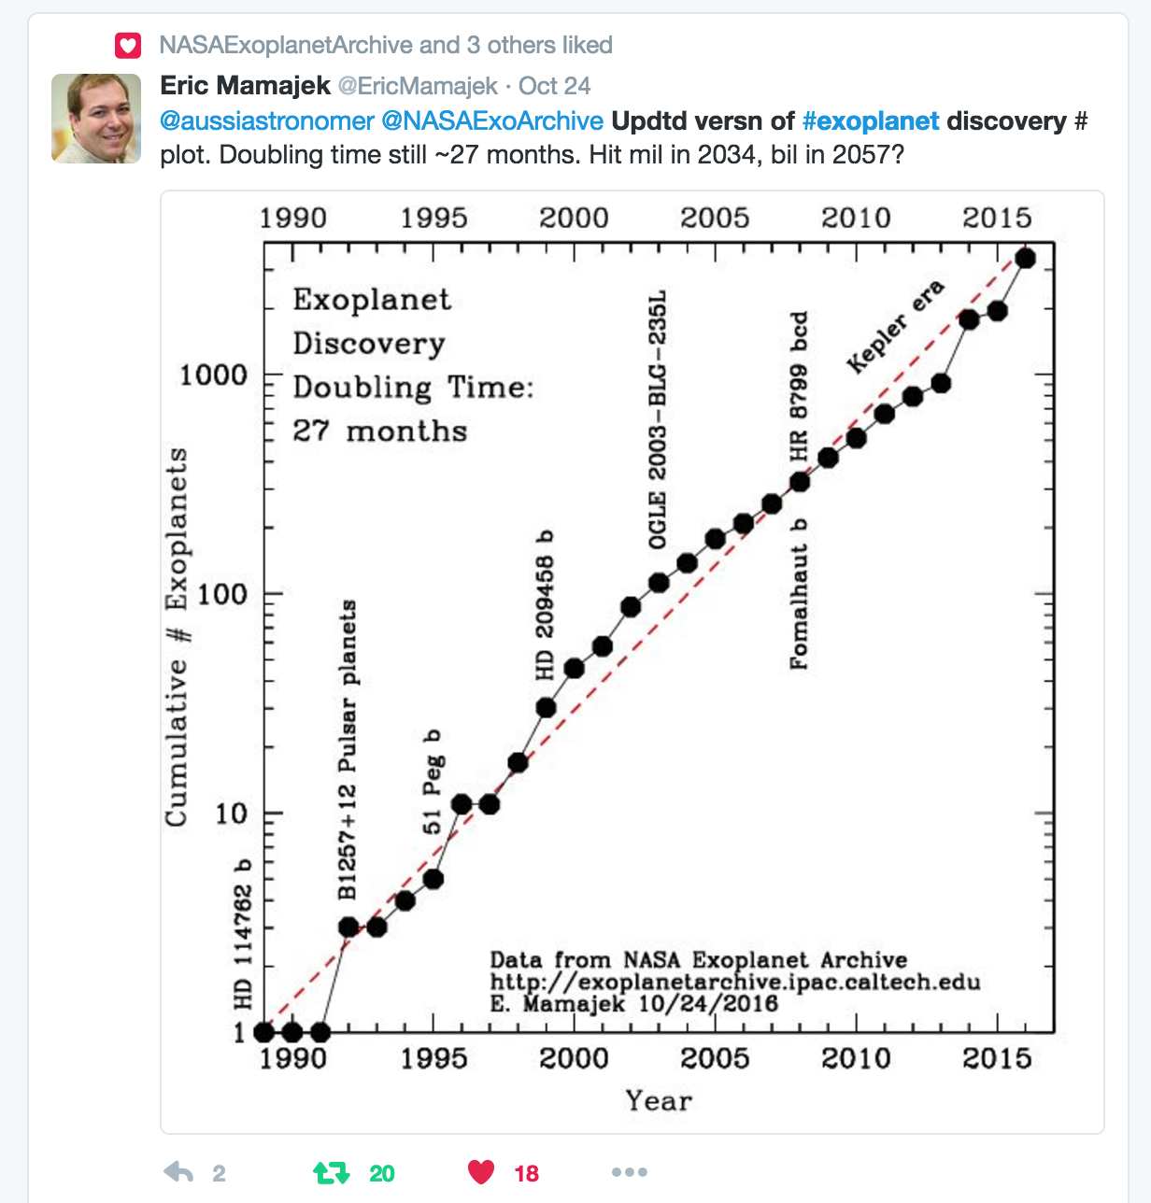
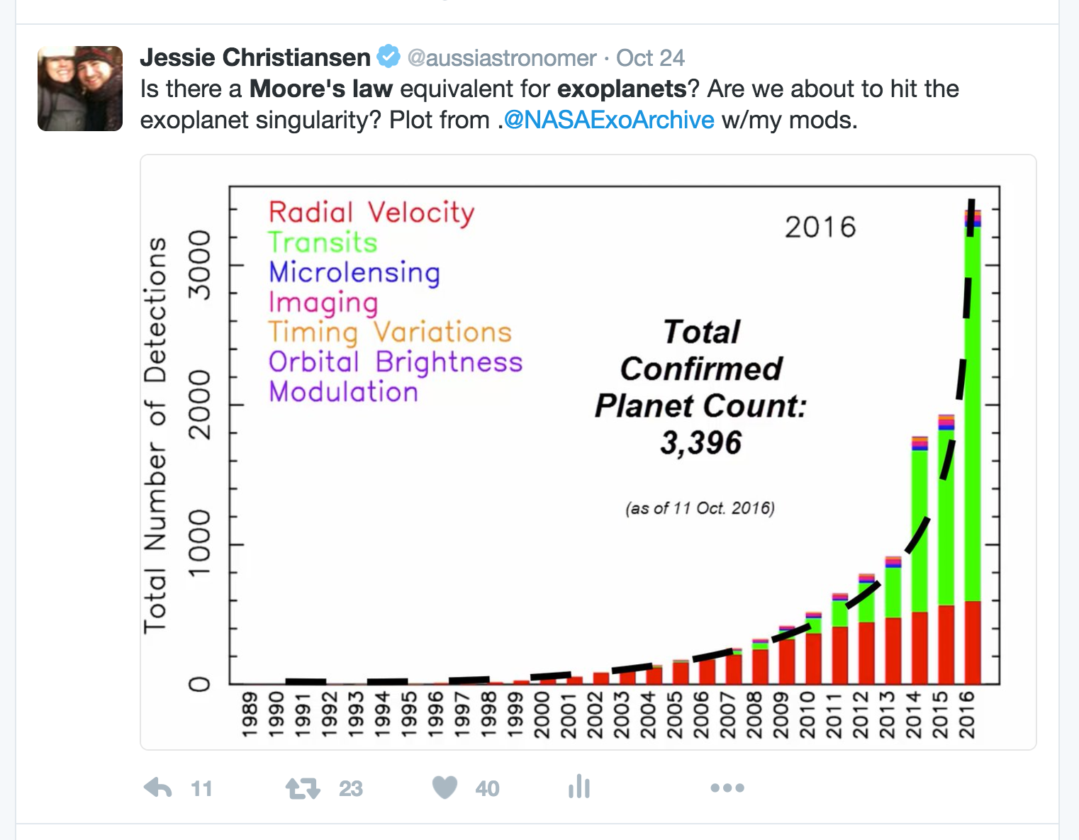
The number of known exoplanets has been increasing exponentially for 25 years…
Mamajek’s Law

Slide 3
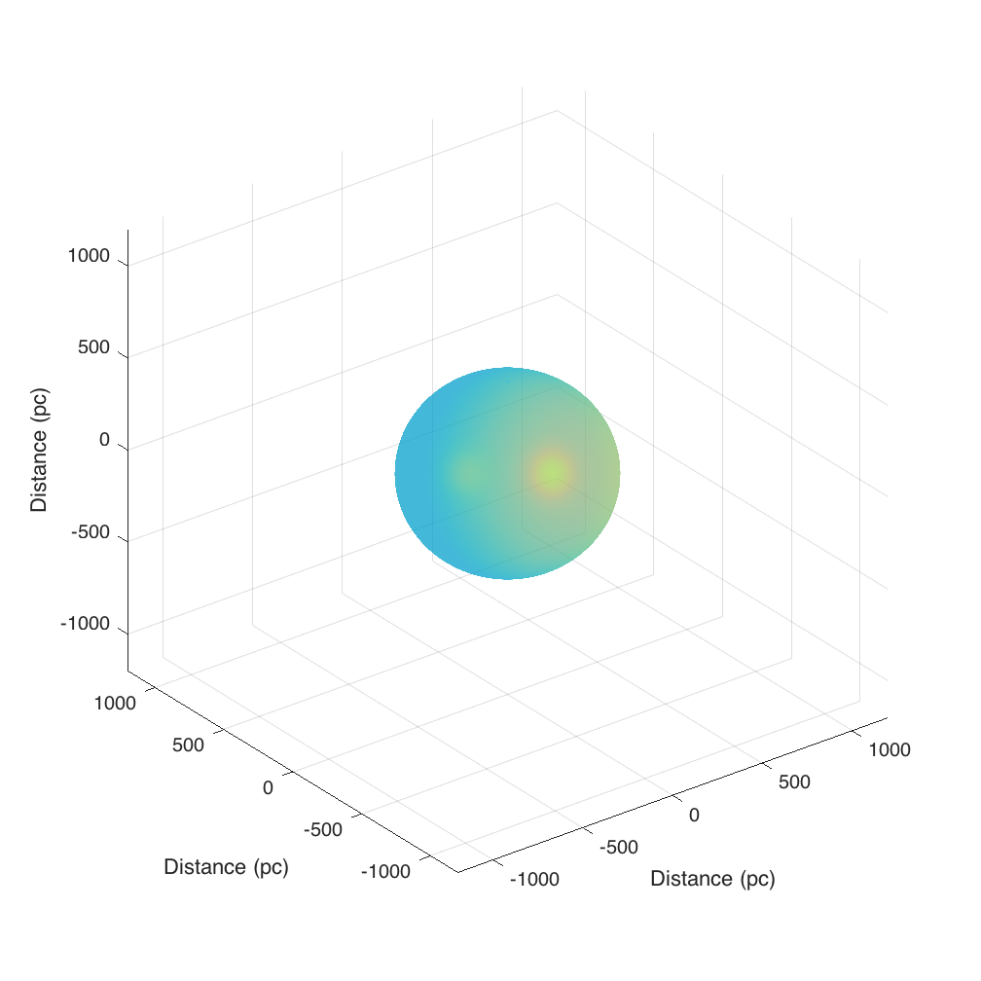
Depth of surveys
Ground-based surveys – reach to 500pc (940 planets)

Slide 4
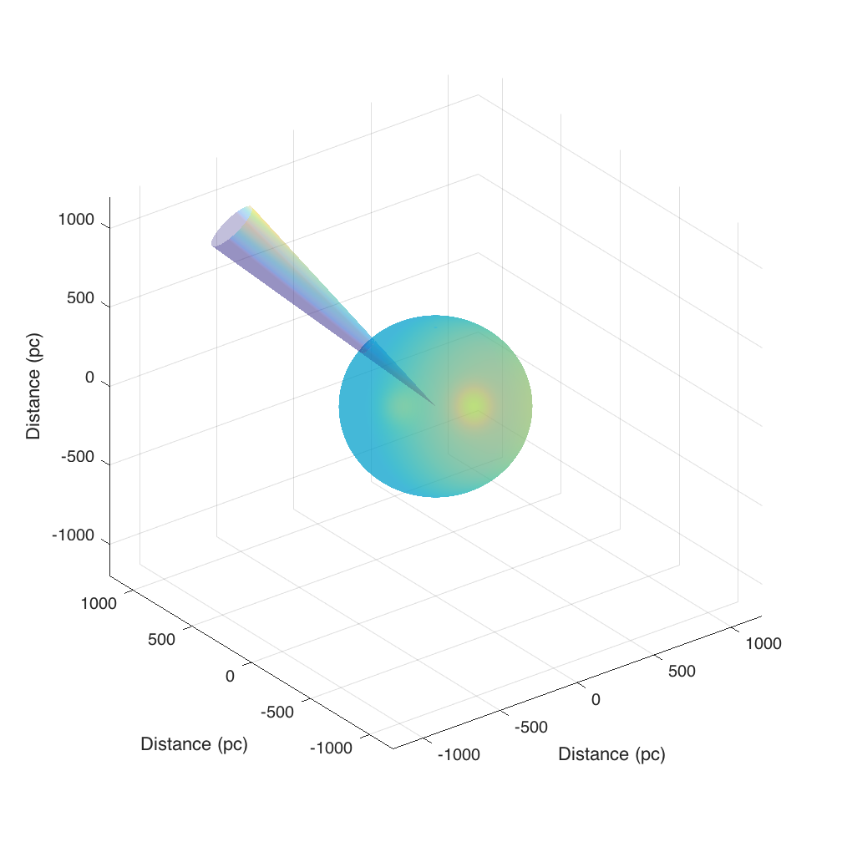
Depth of surveys
Ground-based surveys – reach to 500pc (940 planets)
Kepler survey – reaches to 1500pc
(2331 planets)

Slide 5
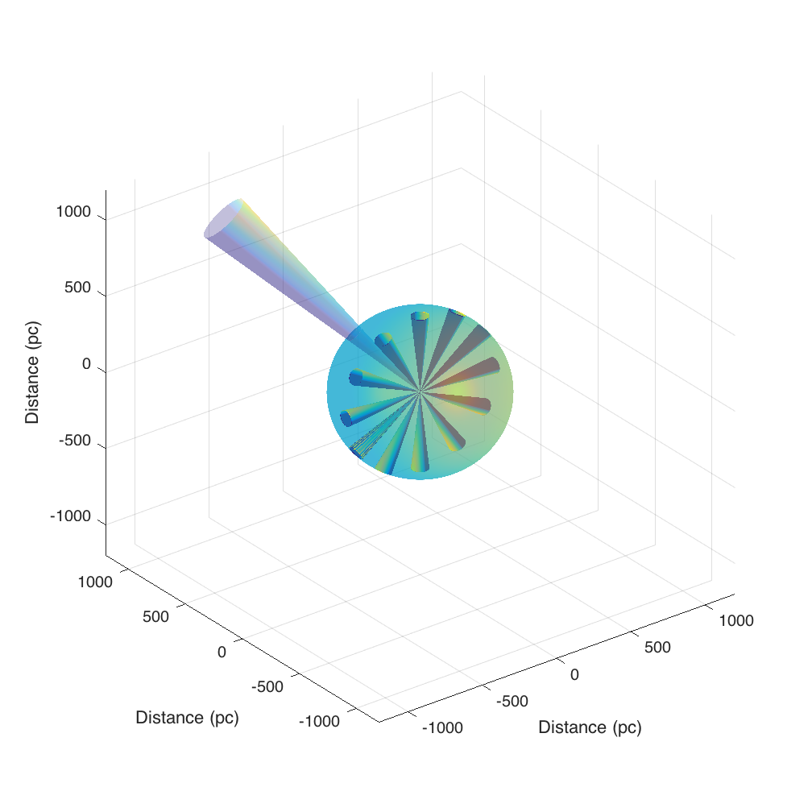
Depth of surveys
Ground-based surveys – reach to 500pc (940 planets)
Kepler survey – reaches to 1500pc
(2331 planets)
K2 survey – reaches to 500pc (178 planets)

Slide 6
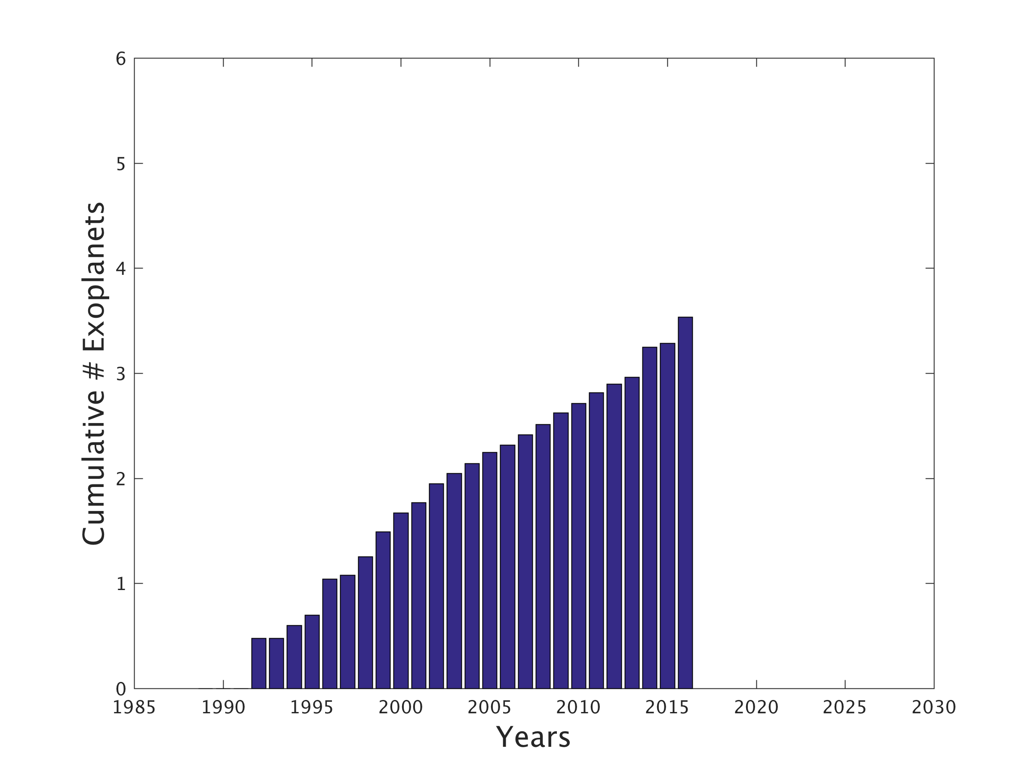
How much longer can Mamajek’s Law last?
Data from NASA Exoplanet Archive
Log₁₀(Cumulative # Exoplanets)

Slide 7
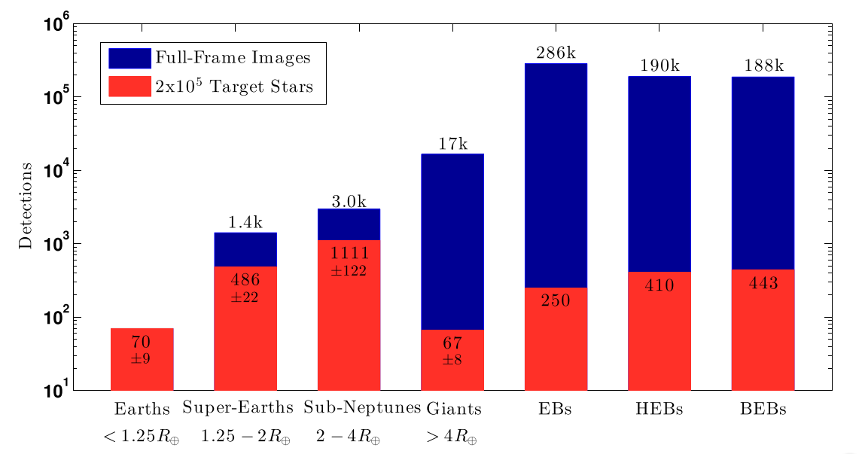
The NASA TESS Mission
Sullivan+2015
23,000 planets
(not planet candidates.... planets)

Slide 8
Depth of surveys
Ground-based surveys – reach to 500pc (940 planets)
Kepler survey – reaches to 1500pc
(2331 planets)
K2 survey – reaches to 500pc (178 planets)

Slide 9
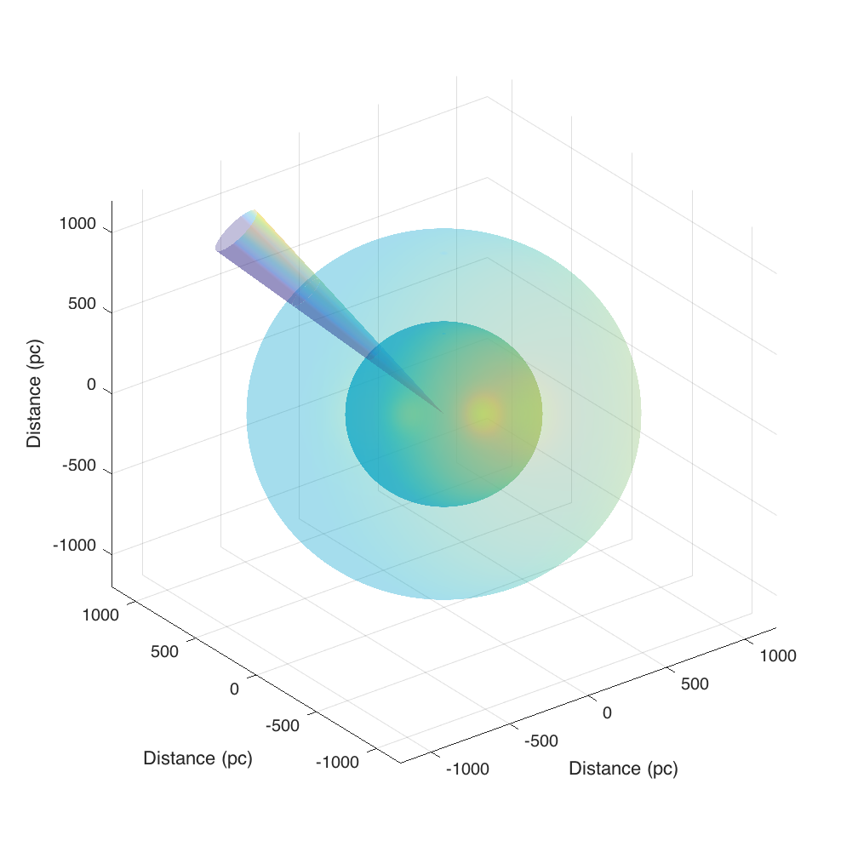
Depth of surveys
Ground-based surveys – reach to 500pc (940 planets)
Kepler survey – reaches to 1500pc
(2331 planets)
K2 survey – reaches to 500pc (178 planets)
TESS survey – reaches to 1000pc

Slide 10
How much longer can Mamajek’s Law last?
Data from NASA Exoplanet Archive
Log₁₀(Cumulative # Exoplanets)

Slide 11
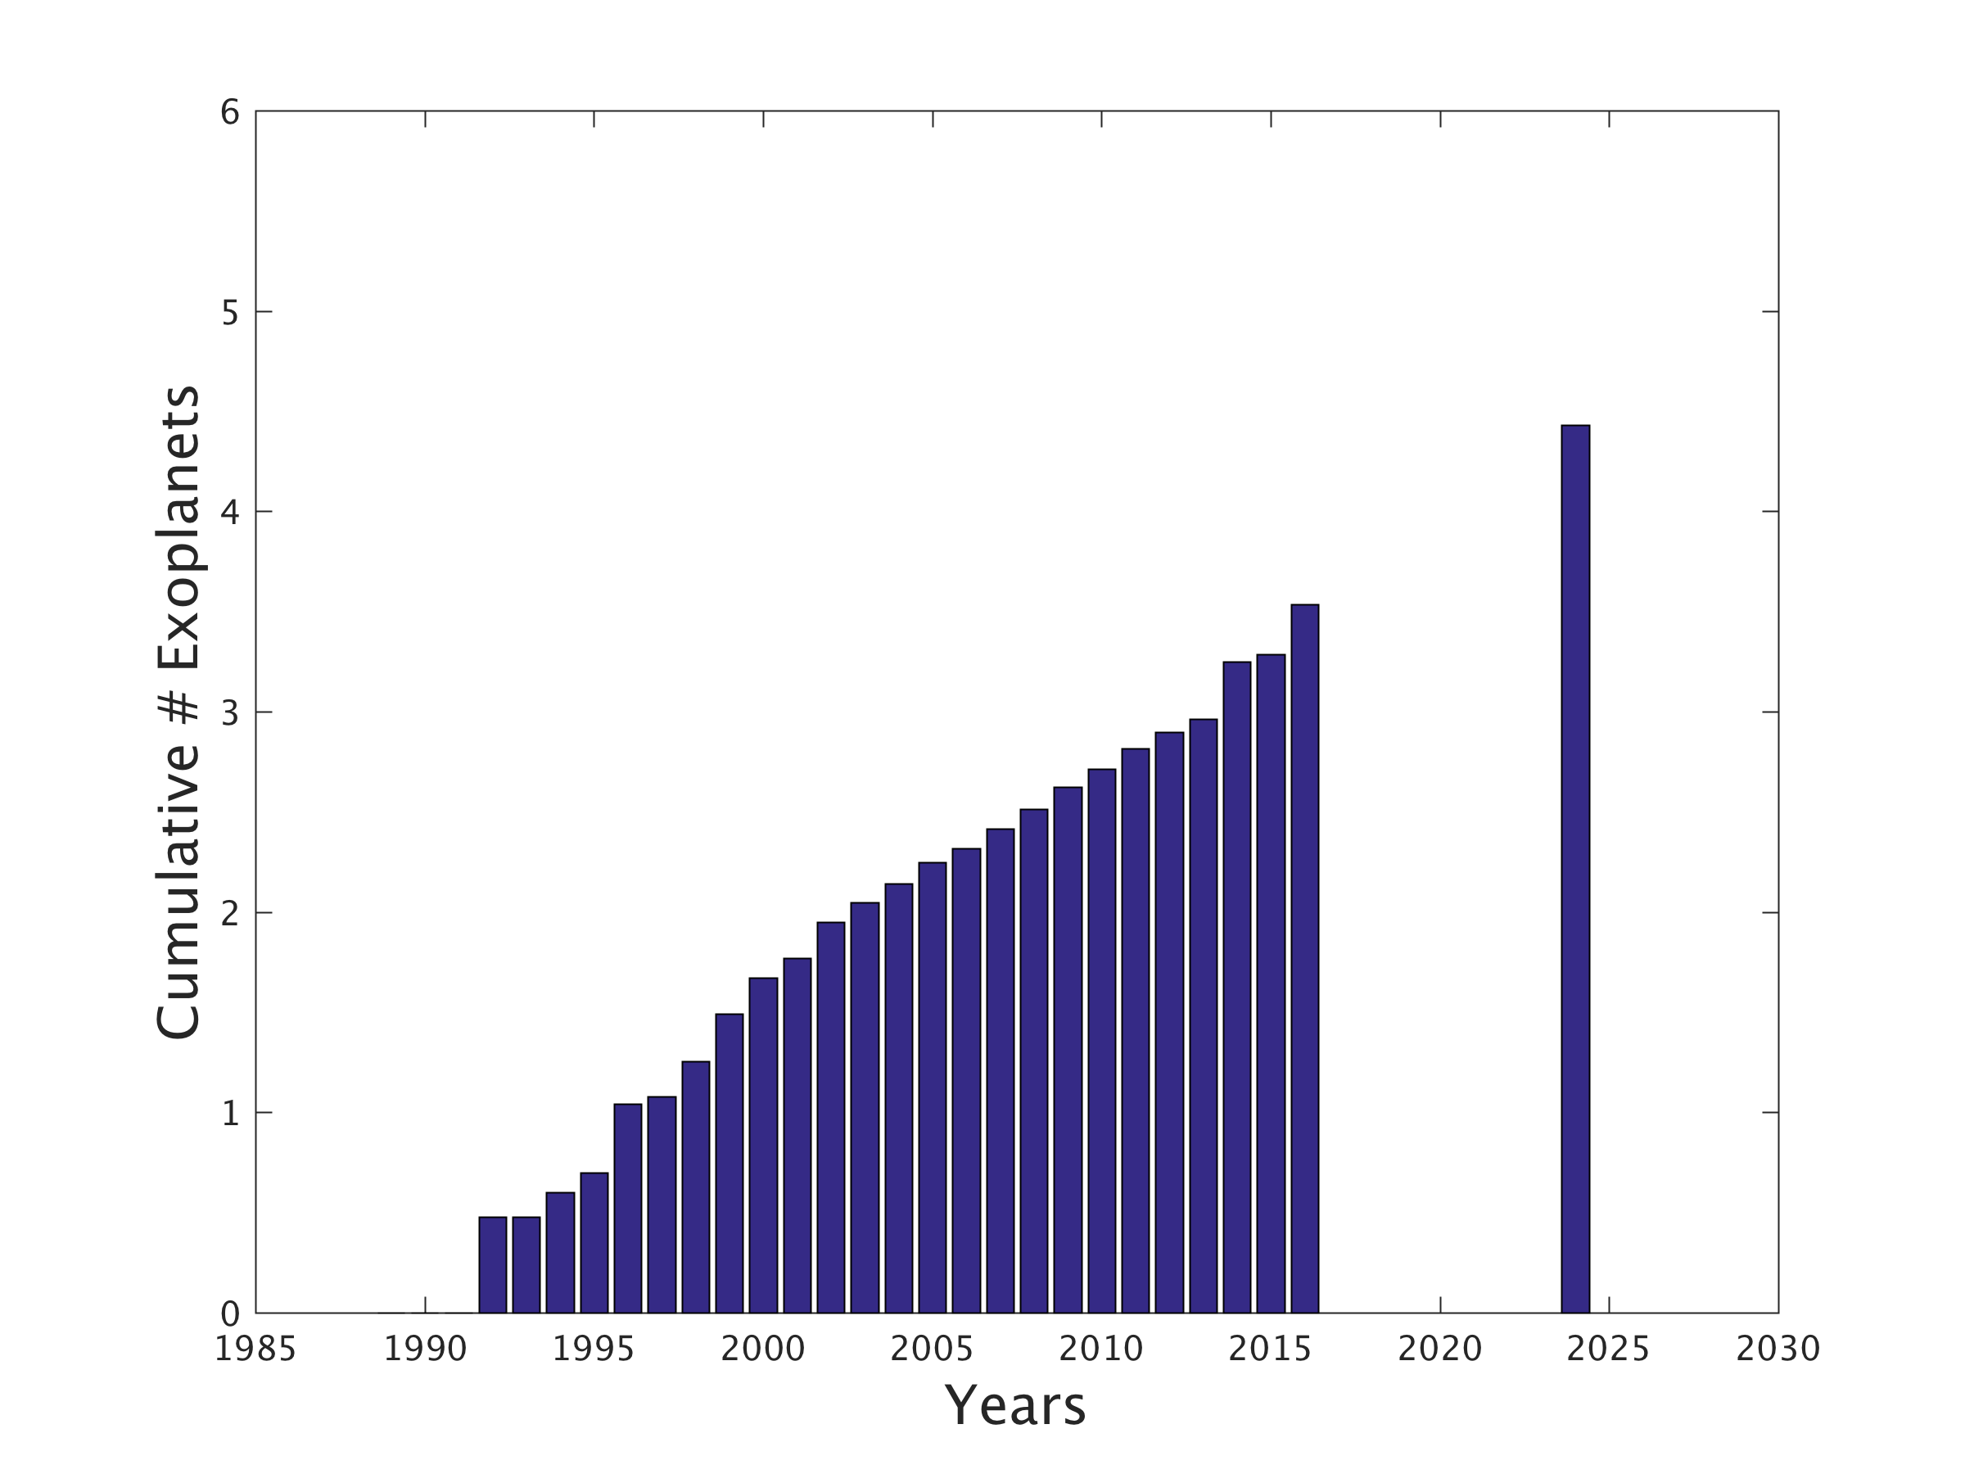
How much longer can Mamajek’s Law last?
TESS – 5 years
Log₁₀(Cumulative # Exoplanets)

Slide 12
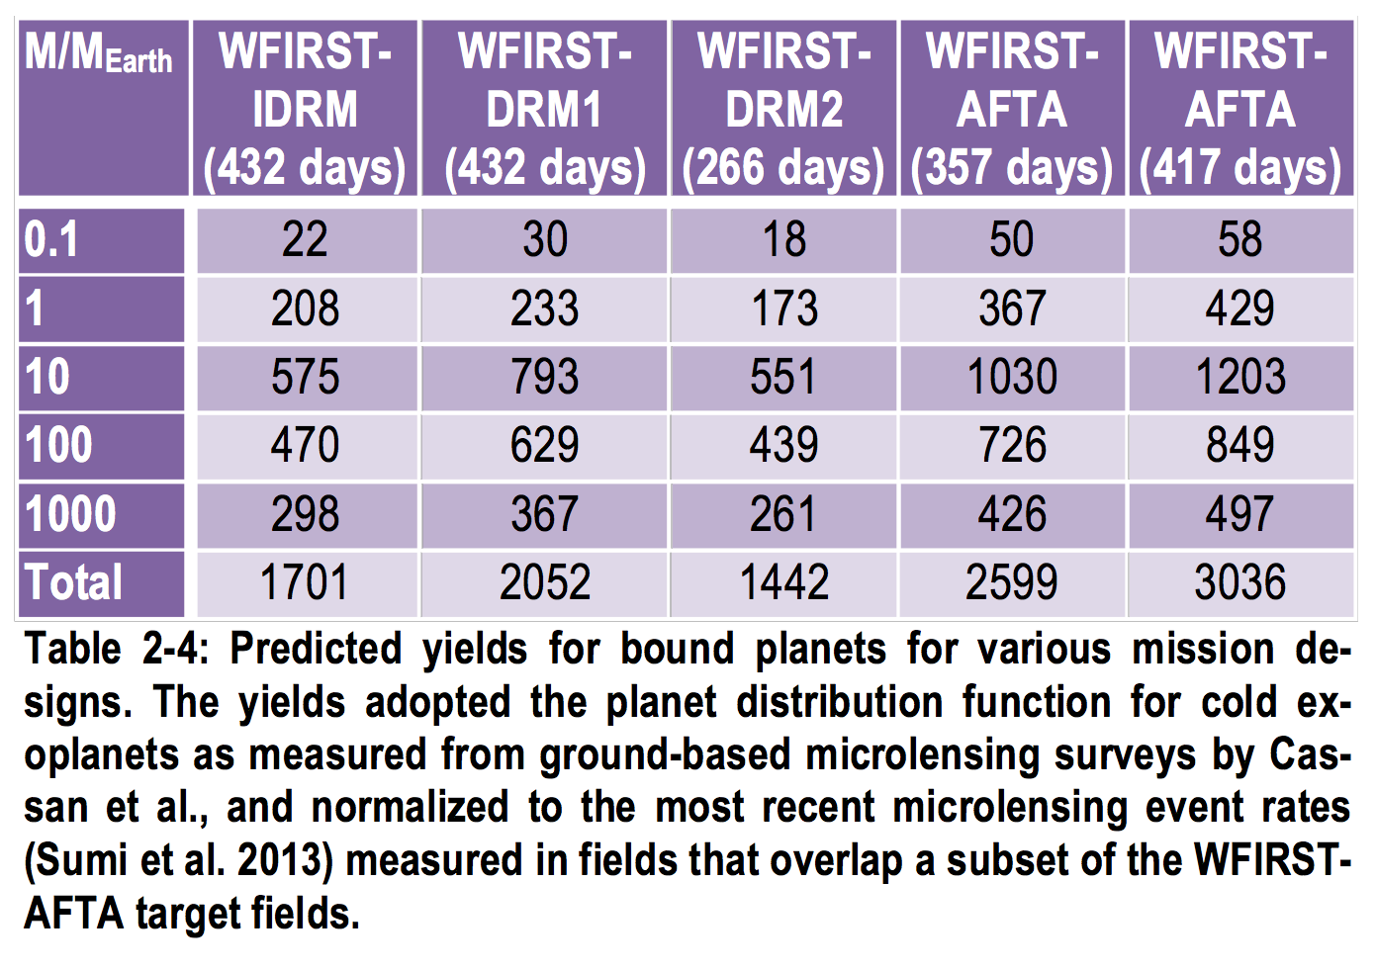
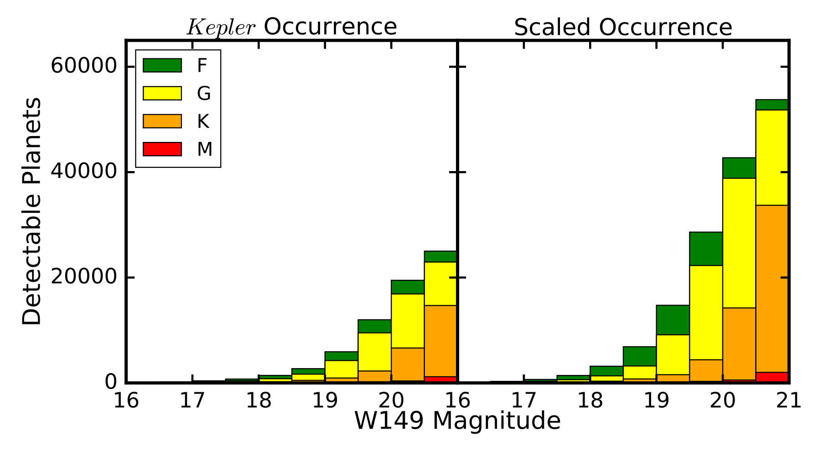
The NASA WFIRST Mission
Microlensing
WFIRST-AFTA 2015 Report
(Spergel et al. 2015)
Transiting
Montet, Yee & Penny 2016
arXiv:1610.03067

Slide 13
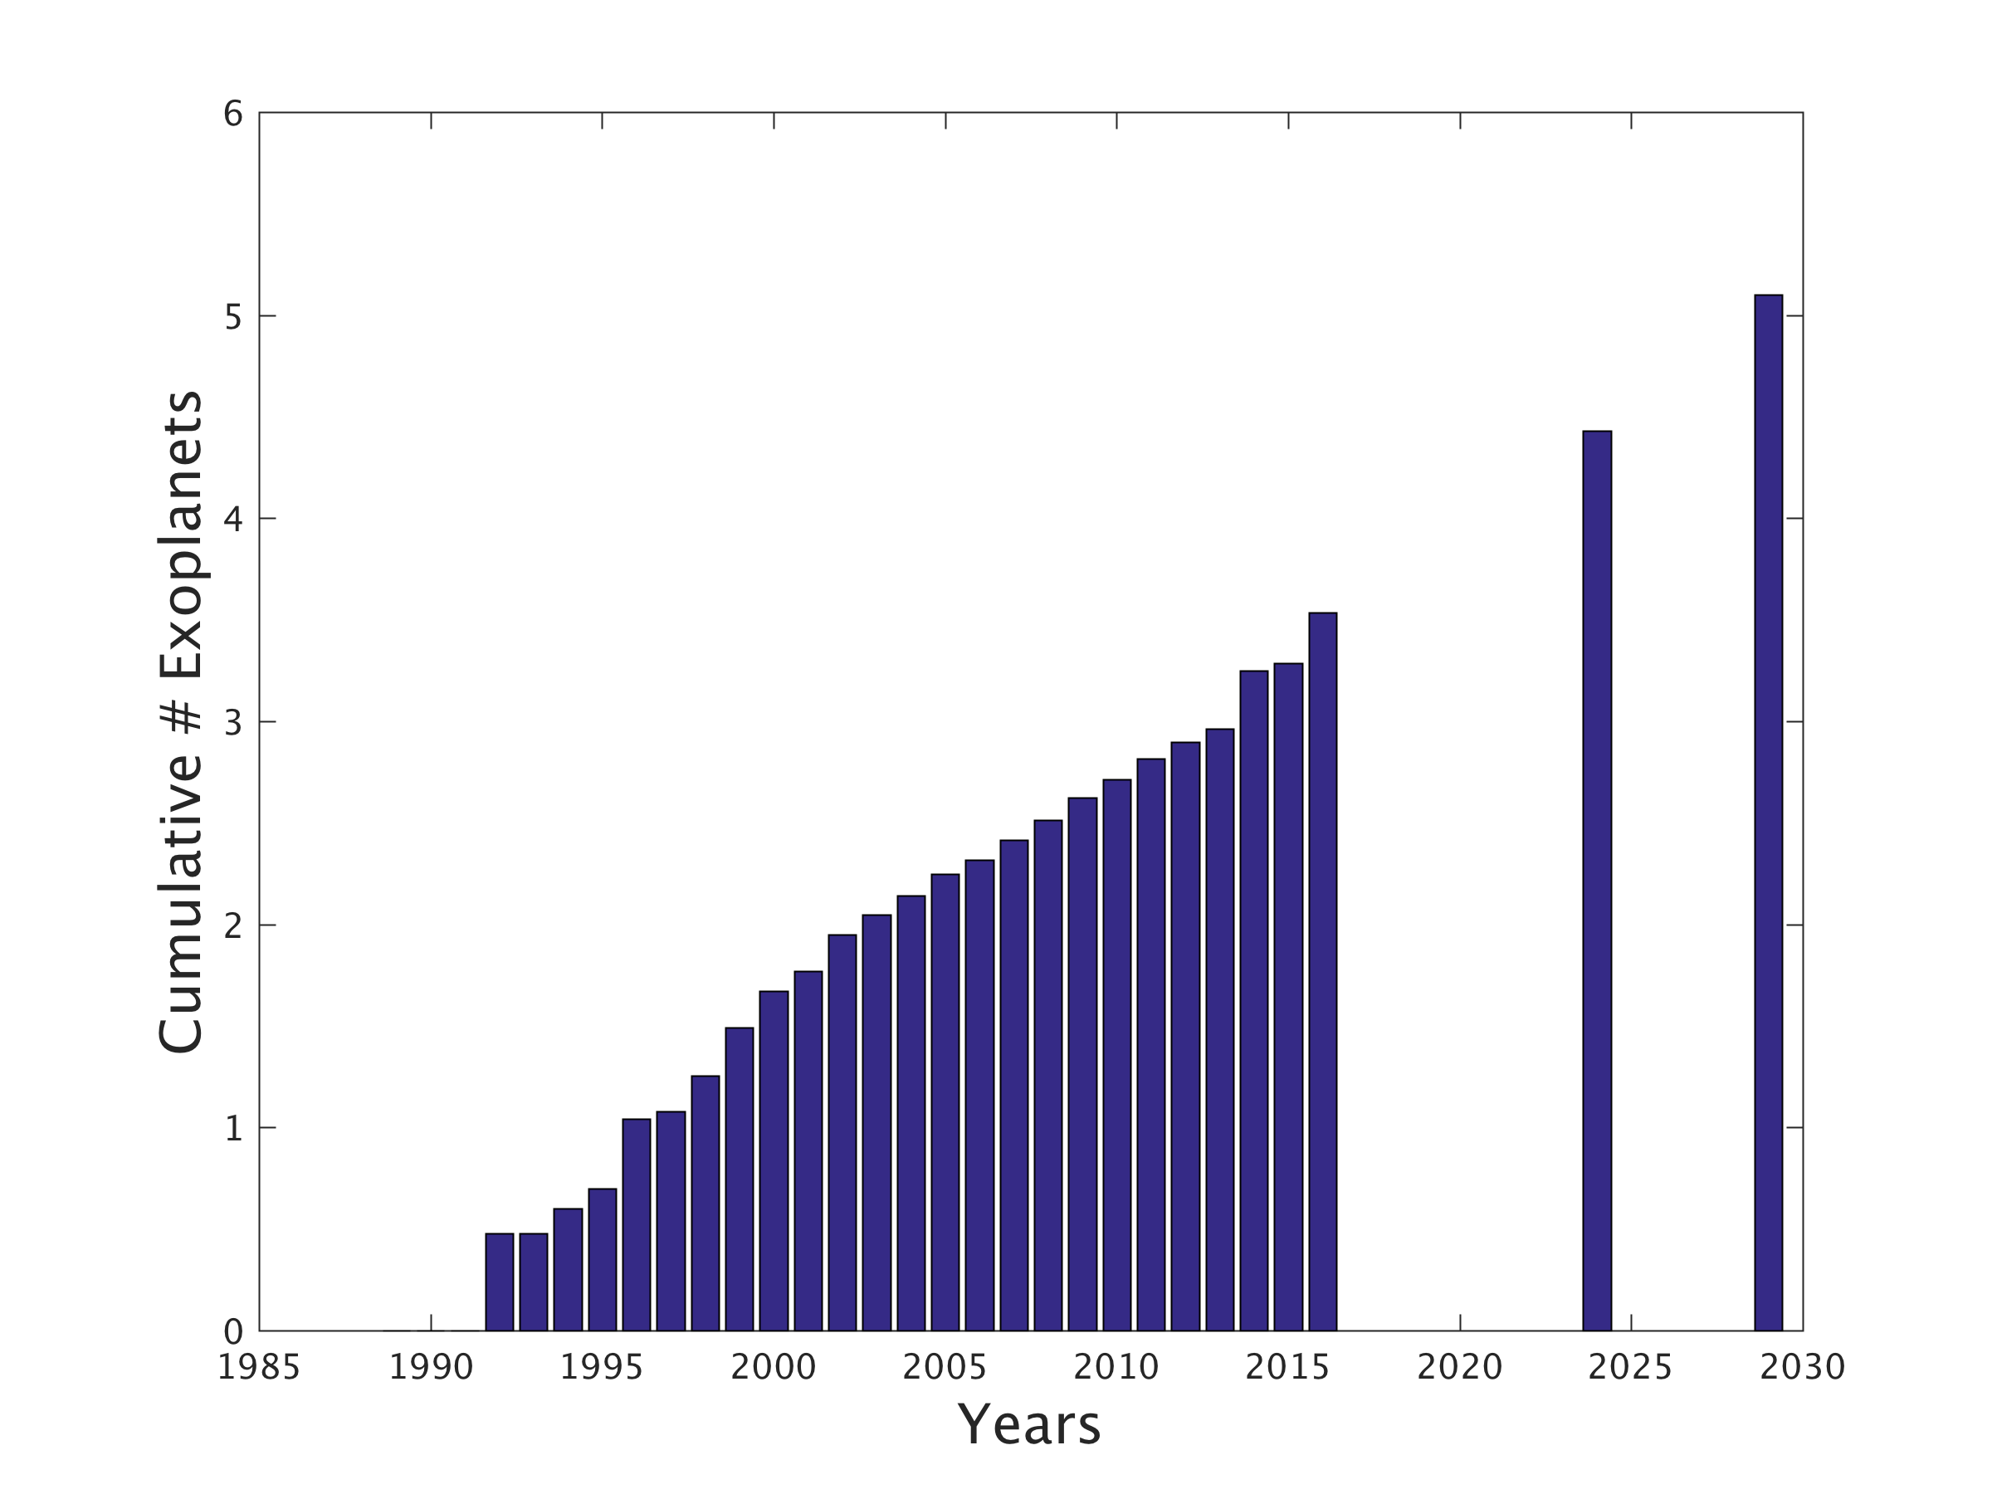
How much longer can Mamajek’s Law last?
WFIRST – 12 years
TESS – 5 years
Log₁₀(Cumulative # Exoplanets)

Slide 14
How much longer can Mamajek’s Law last?
PLATO – ?? years
Log₁₀(Cumulative # Exoplanets)

Slide 15
The legacy of K2 and TESS…
The future is…
Exoplanets!
Kepler has been successful at exploring the myriad planets and planetary systems
But…“TESS is going to discover the planet we study for the next 100 years.” – Joe Harrington, 2012
JWST, LUVOIR/HabEx will have a momentous task!
Astrophysics!
K2 and TESS will leave behind one of the largest archives of extremely high precision time series photometry, allowing unprecedented studies of:
The life and death of stars
Clusters and cluster environments
Solar system science
The origin and nature of AGN activity

