Slide 1
Introduction to ExoFOP Jessie Christiansen Sagan Summer Workshop, July 27 2018

Slide 2
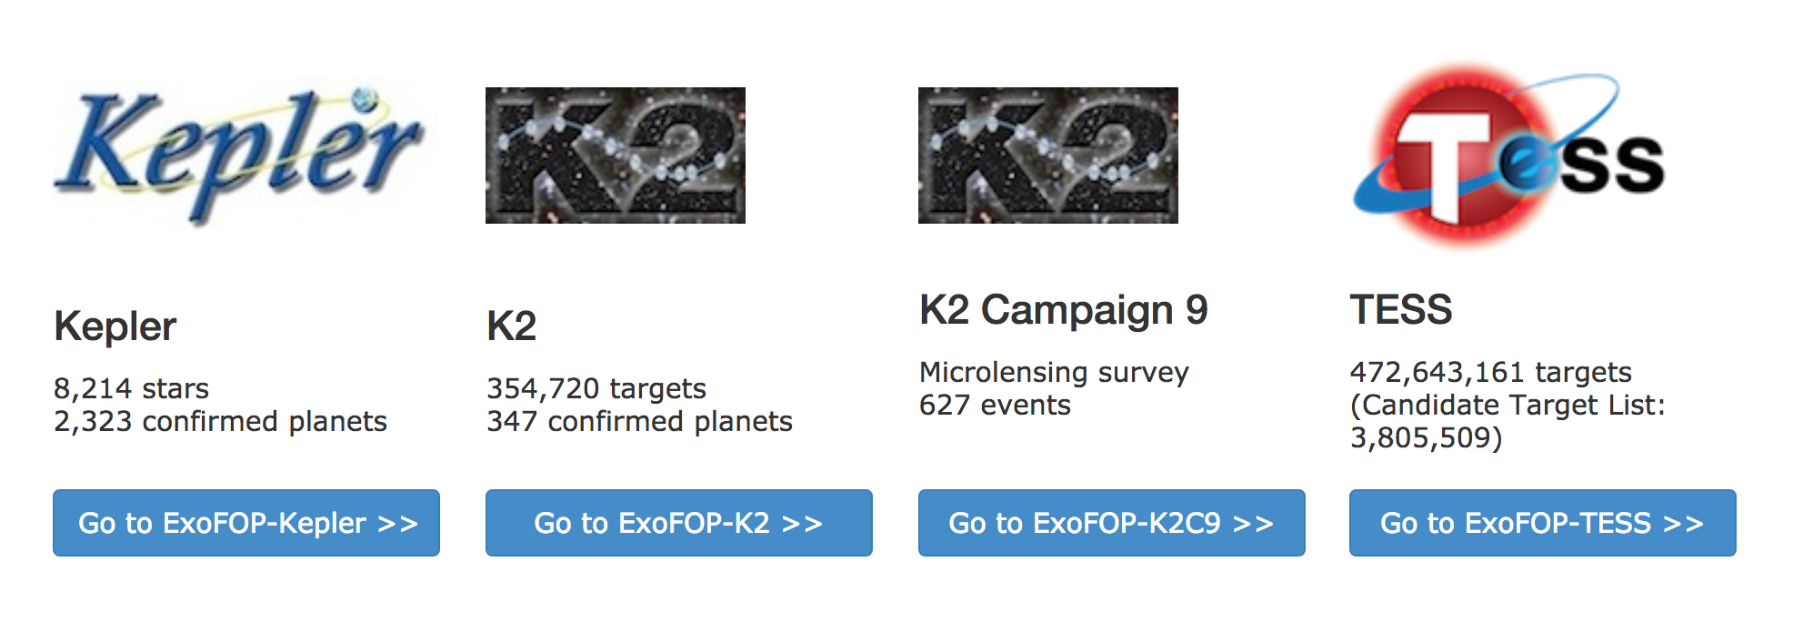
What is ExoFOP?
ExoFOP is funded by NASA HQ to support the community doing follow-up observations of Kepler, K2 and TESS planet candidates

Slide 3
ExoFOP-Kepler

Slide 4
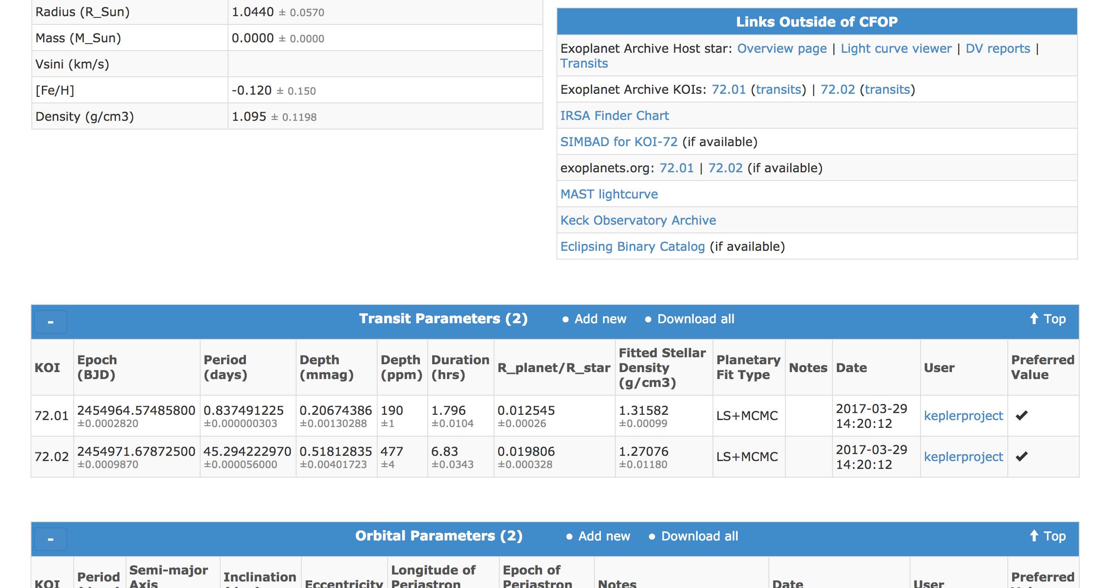
ExoFOP-Kepler Overview Page - Summary

Slide 5
ExoFOP-Kepler Overview Page - Parameters

Slide 6
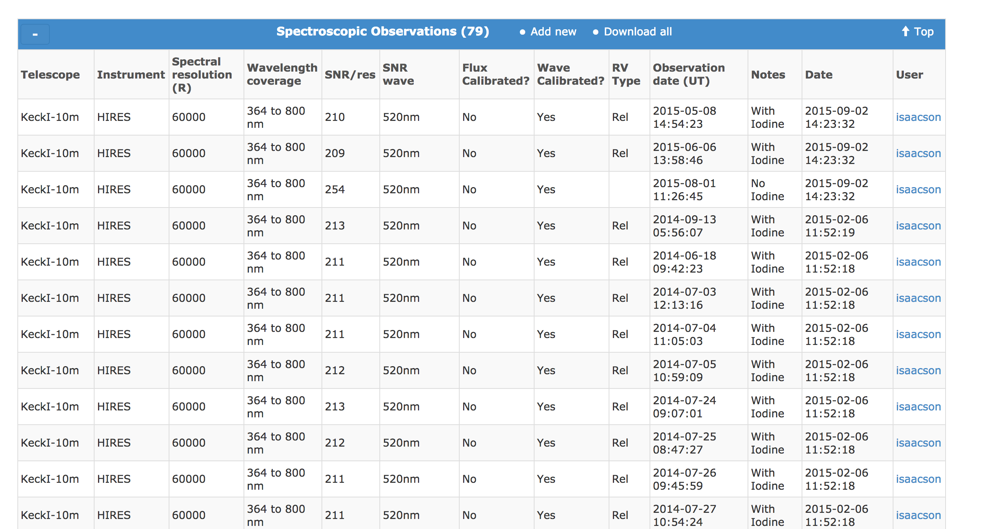
ExoFOP-Kepler Overview Page – Observation Summaries

Slide 7
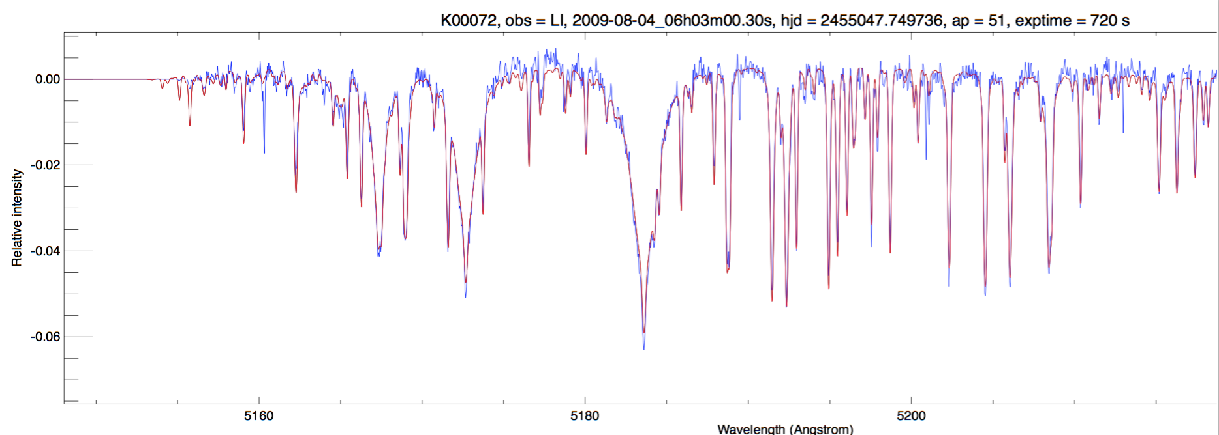
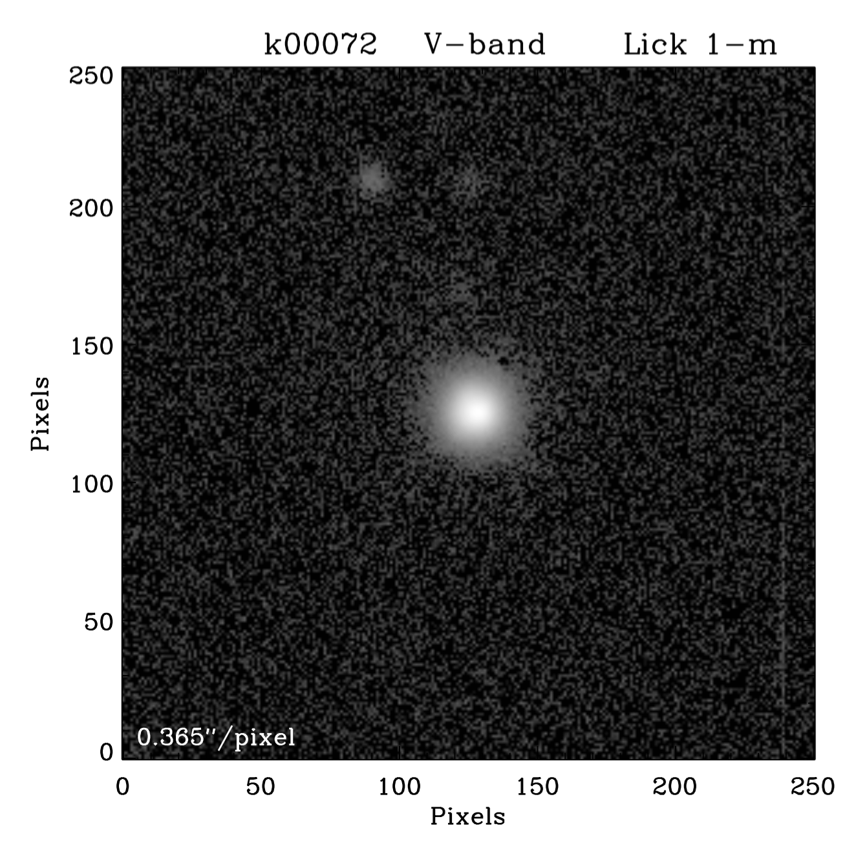
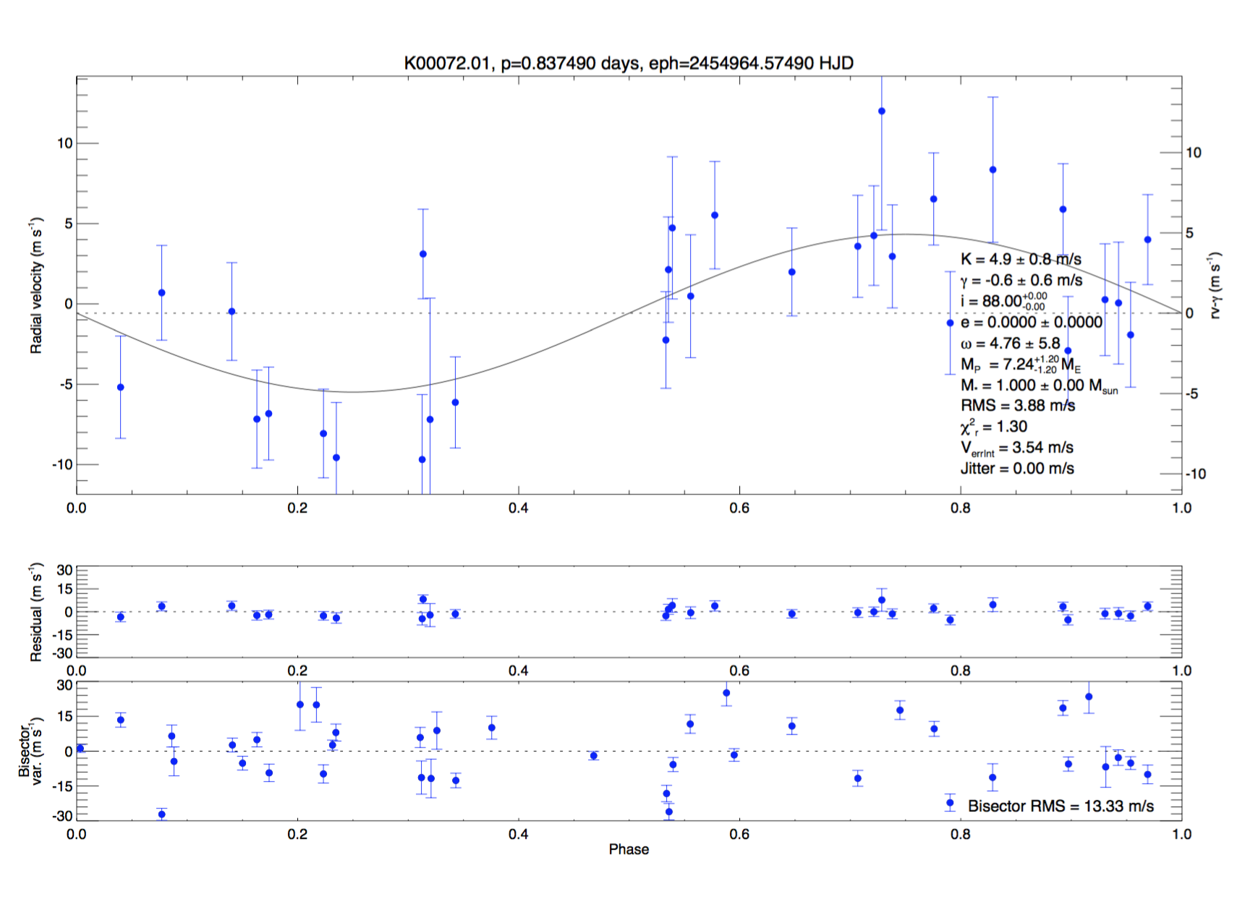
ExoFOP-Kepler Overview Page – Files

Slide 8
ExoFOP-Kepler Usage

Slide 9
ExoFOP-K2 – The Wild West

Slide 10
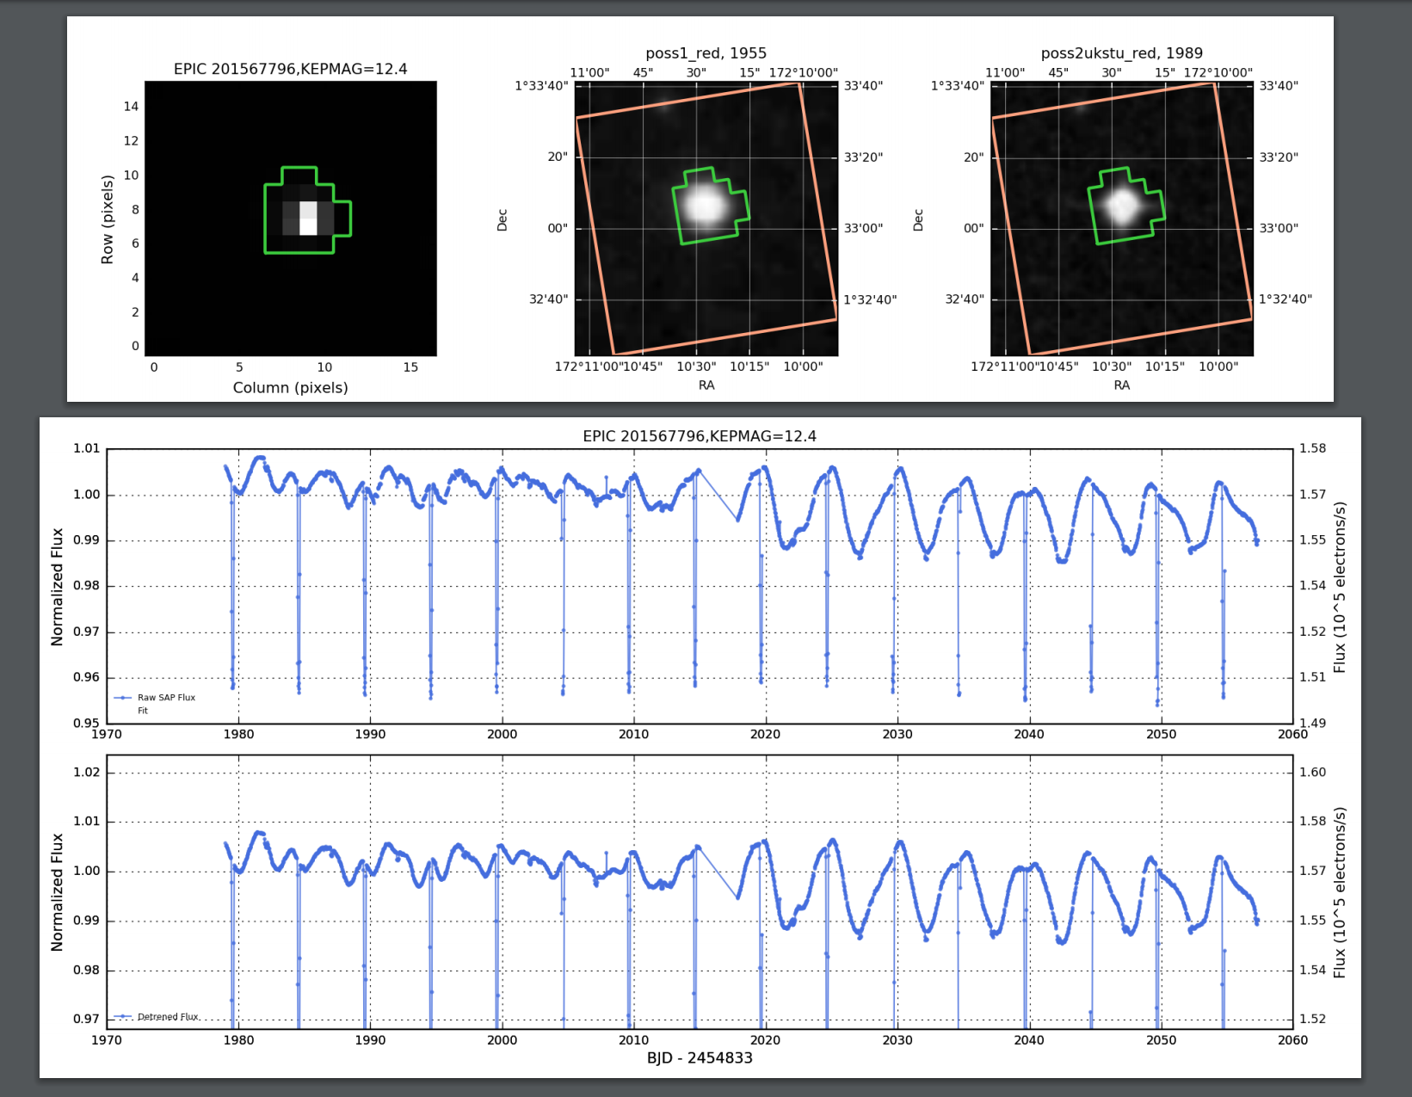
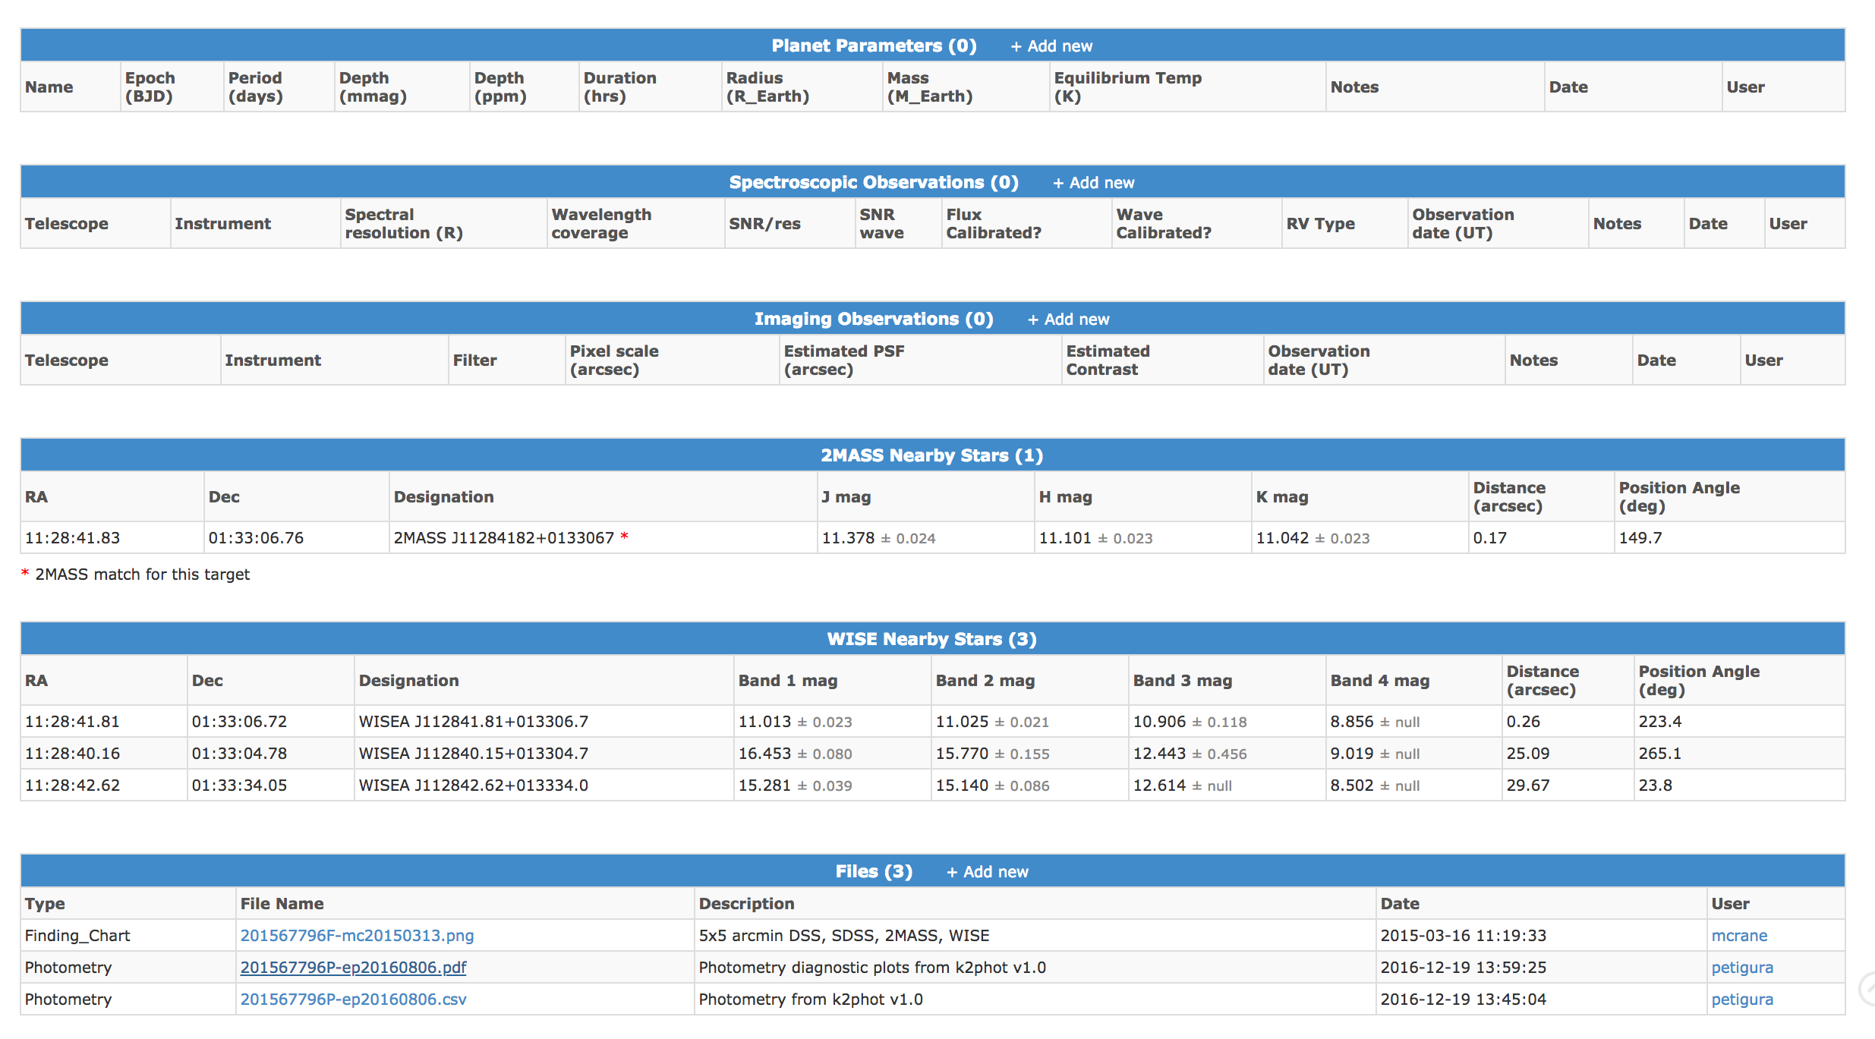
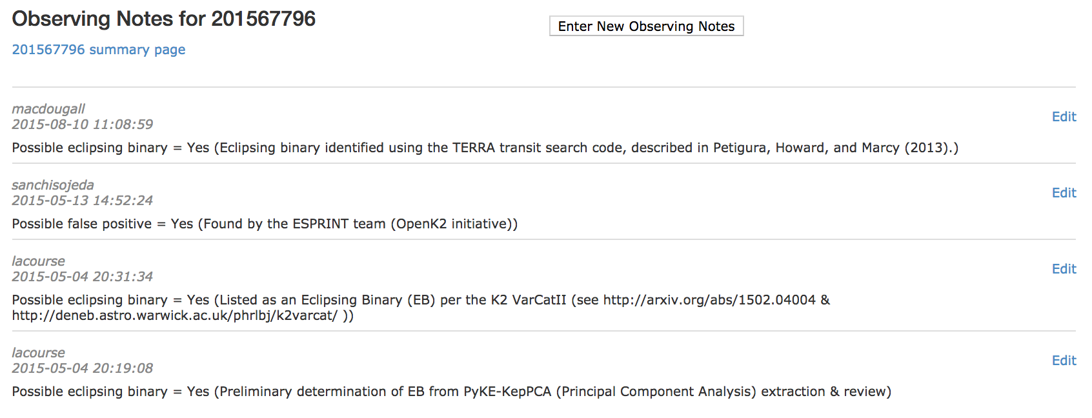
ExoFOP-K2: False positive example

Slide 11
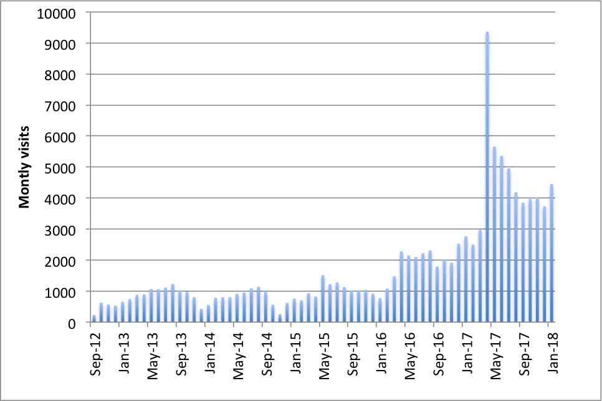
ExoFOP-K2 Usage

Slide 12
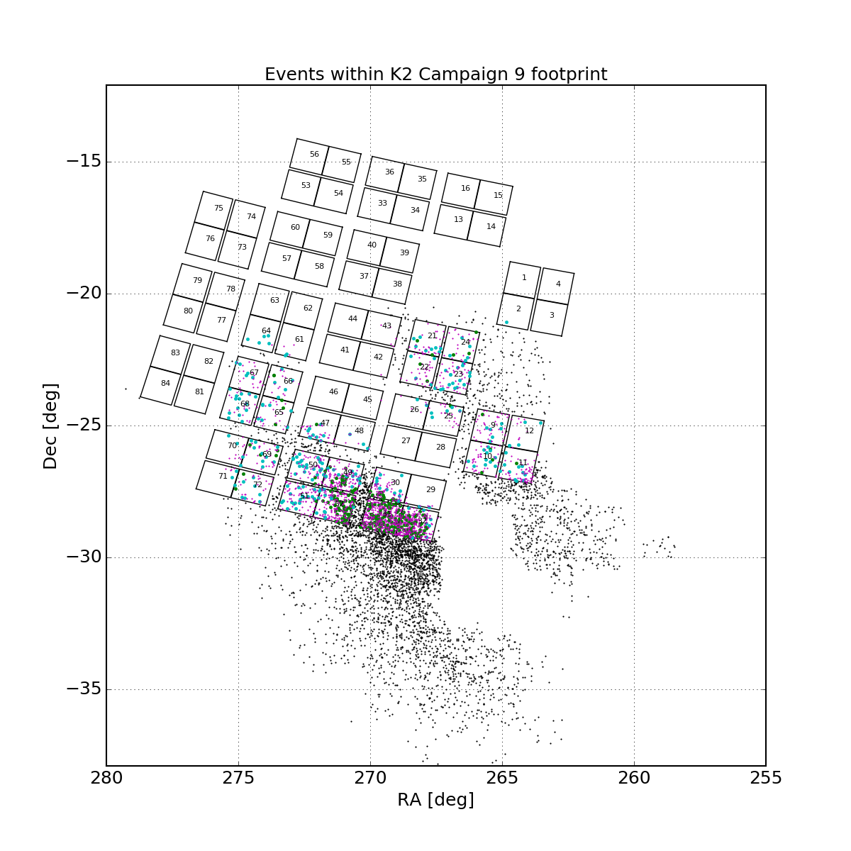
ExoFOP-K2C9

Slide 13
ExoFOP-TESS
NASA Exoplanet Archive is funded by NASA HQ to support the community doing follow-up observations of TESS targets.
We aim to support the TESS Project, Science Office, GO Office, and MAST in their engagements with the broader community.
This is largely through the development of ExoFOP-TESS, aiming to:
Help the project and community coordinate and collaborate on observations
Host the project and community follow-up observations
Integrate data with existing tools and develop new tools
Make many levels of data accessible via API (callable via script) for people who already have their own portals developed
ExoFOP-TESS is live!

Slide 14
ExoFOP-TESS

Slide 15
ExoFOP-TESS – TOI List
We will be pulling the publicly available TOI parameters from MIT as they are updated (~daily) and automatically populating the overview pages with the TOI parameters
Each TOI will be assigned a set of initial priorities by TFOP for follow-up, depending on the parameters of the candidate
The current plan is to display initial priorities, and then have the priorities updated by TFOP to reflect the current state of the knowledge of the target
As TOIs are re-observed in subsequent sectors we will append parameters to the TOI parameter table (we will not overwrite previous parameters as was done for Kepler)
We are still developing how and where to best integrate community objects of interest that do not come out of the QLP or SPOC pipeline

Slide 16
ExoFOP-TESS – TOI List

Slide 17
ExoFOP-TESS: Overview pages

Slide 18
New functionality – data tagging!
Previously the observation summaries, notes, files and derived parameters were not linked/integrated in any formal way
Every upload (interactive or bulk upload) to ExoFOP-TESS is now either associated with an existing tag (set by user)
The format of the tag string is
YYYYMMDD_username_description_nnnn
E.g. 20180201_christiansen_k2-138-spectra_12
E.g. 20180712_eastman_toi7417-exofast2-fits_1
Each tag string is associated with a unique tag integer, which is what appears on the overview pages
Clicking on a tag identifier brings up a summary of all the observation summaries, notes, files and parameters associated with that tag
You can upload new data objects and associate them with (one of) your previous tags
Observation summaries
Derived parameters
Files
Observing notes

Slide 19
New functionality – TFOP proprietary access!
We have developed new requested functionality: the ability for data files and derived parameters to have a proprietary access period limited to members of the TFOP
The observation summary information, any TFOP priorities, and the publically available TOI parameters will be public
For data files and derived parameters, members of the TFOP group will be able to specify a proprietary period of 0 or 12 months – some sub-groups are expecting to make their data public immediately (e.g. recon spectra, as is already happening for K2), and some are not (e.g. precision radial velocities)

Slide 20
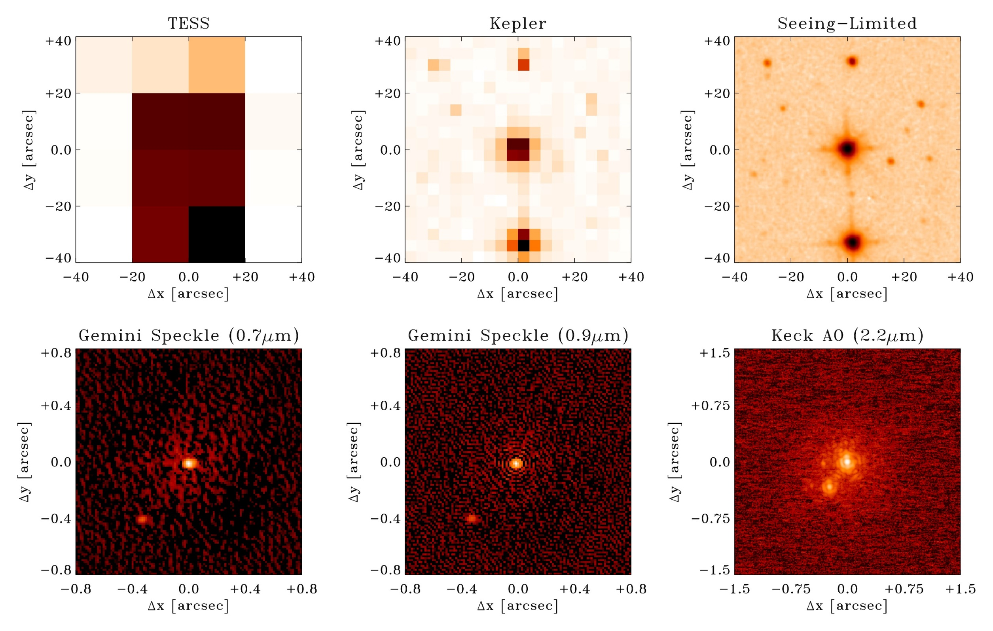
New functionality – Time-series observation summaries
TESS will lean much more heavily on ground-based time-series follow-up to identify which star in a given TESS pixel is the source of the dimming
TFOP-SG1 will coordinate ground-based follow-up

Slide 21
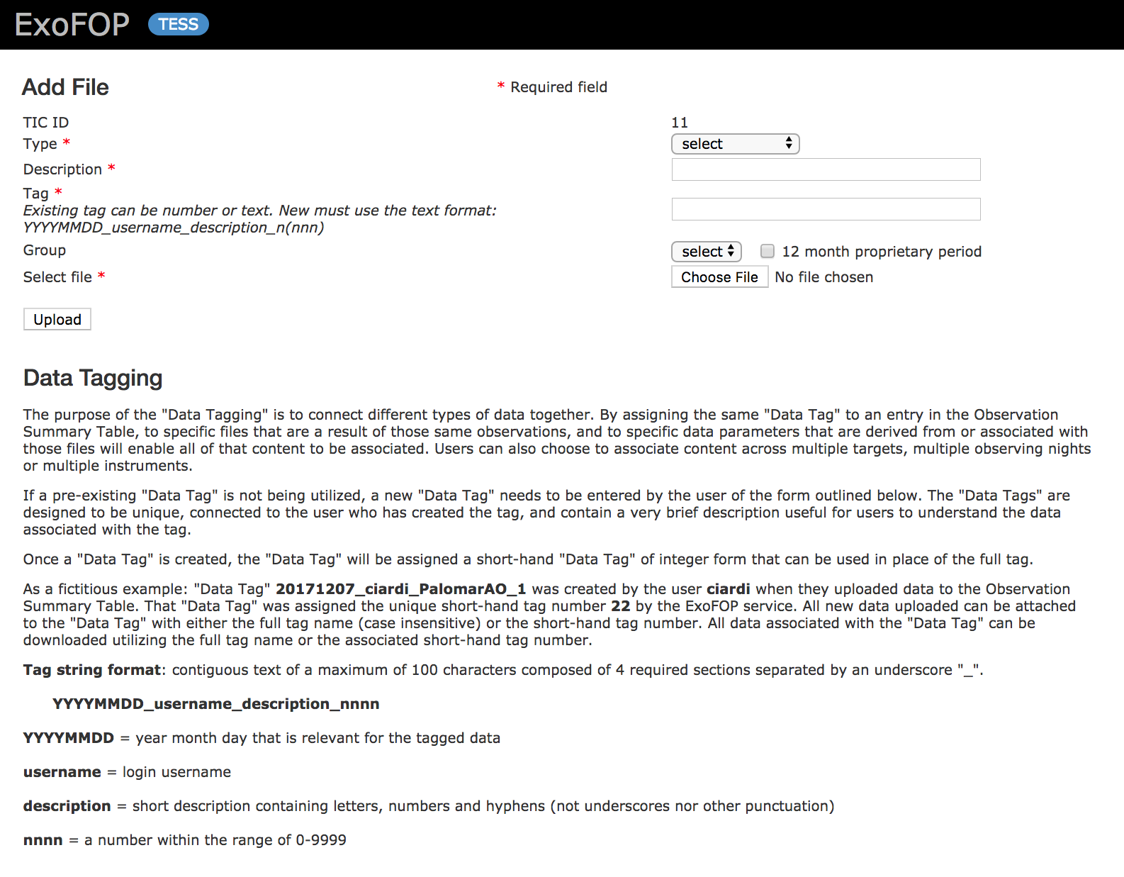
ExoFOP-TESS - Uploading data
Individually:

Slide 22
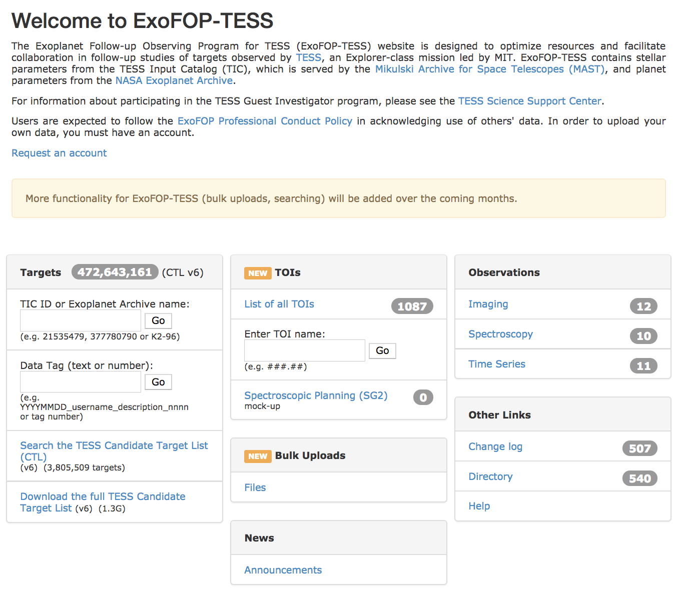
ExoFOP-TESS - Uploading data
Individually:
In bulk:
Name your individual files according to the naming convention: TIC377780790S-mc20180311.pdf
Create a descriptor text file: mc20180410-001.txt Columns: filename|data tag name or number|group name|proprietary period|file description
Tar/zip the files together: mc20180410-001.tar or mc20180410-001.zip (same file name as descriptor file but with .tar or .zip extension)
Upload the tar/zip file (maximum file size = 1GB)
You will receive immediate confirmation regarding the success or failure of your bulk upload

Slide 23
ExoFOP-TESS – EXOFAST2 products
Jason Eastman has been working on EXOFAST2, an update of the publicly available EXOFAST transit and RV fitting code specifically for TESS
MCMC transit fitting of TOIs, terminates after 10,000 steps *or* when all parameters have >1000 independent draws and their Gelman-Rubin convergence statistic is <1.1
This means not all searches converge and these should be considered preliminary fits for follow-up priority setting, not publication-suitable fits
Products include:
Transit fit priors
Transit fit final parameters and uncertainties
Detrended light curve used in fitting
Plots of MCMC chains and covariance of parameters
Plot of phased light curve with best fit model overlaid
Full IDL sav files of the MCMC chains
We are working to automatically ingest and populate these products onto the ExoFOP-TESS overview pages, including custom tables of transit fit parameters

Slide 24
ExoFOP-TESS – Timeline
Implemented
Entire TIC available (overview pages generated on the fly)
Full searching on the Candidate Target List (~4 million targets)
Interactive upload of notes, files, observation summaries and parameters
Interactive download
Bulk upload of files
New group functionality
New tagging functionality
Coming next
TOI lists, priorities, publicly available parameters
API download of notes, files, observation summaries and parameters
MyTOIs
Longer term
EXOFAST2 products

Slide 25
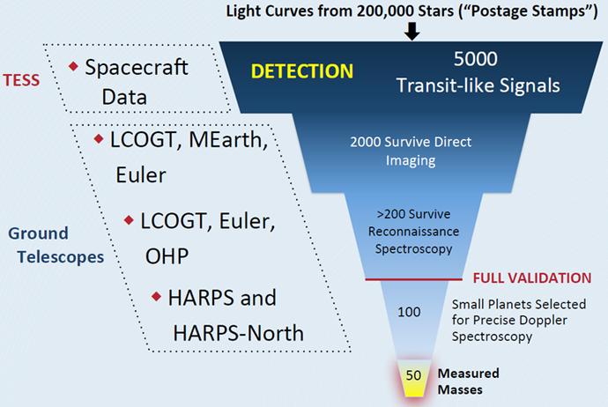
Summary – we’re preparing for the deluge
X 100! (FFIs)

