Slide 1
What Makes A Survey *☆*Useful*☆* For Demographics
Jessie Christiansen
Caltech/IPAC-NASA Exoplanet Science Institute

Slide 2
Overview
01
02
03
Why?
What?
Do’s
04
05
06
DON’TS!
Example
Resources

Slide 3
01
Why
…should you listen to this talk?

Slide 4
Do you…
Want to assess if a survey is suitable for your needs?
Want to perform a survey?
Want to know how not to use data?
Referee papers on any of the above?

Slide 5
02
What
…is the problem we’re trying to solve?

Slide 6
Astro2020, Goal 1:
“to understand the formation and evolution of planetary systems as products of the process of star formation, and characterize and explain the diversity of planetary system architectures, planetary compositions, and planetary environments produced by these processes”
Finding: "Current knowledge of the demographics and characteristics of planets and their systems is substantially incomplete.”

Slide 7
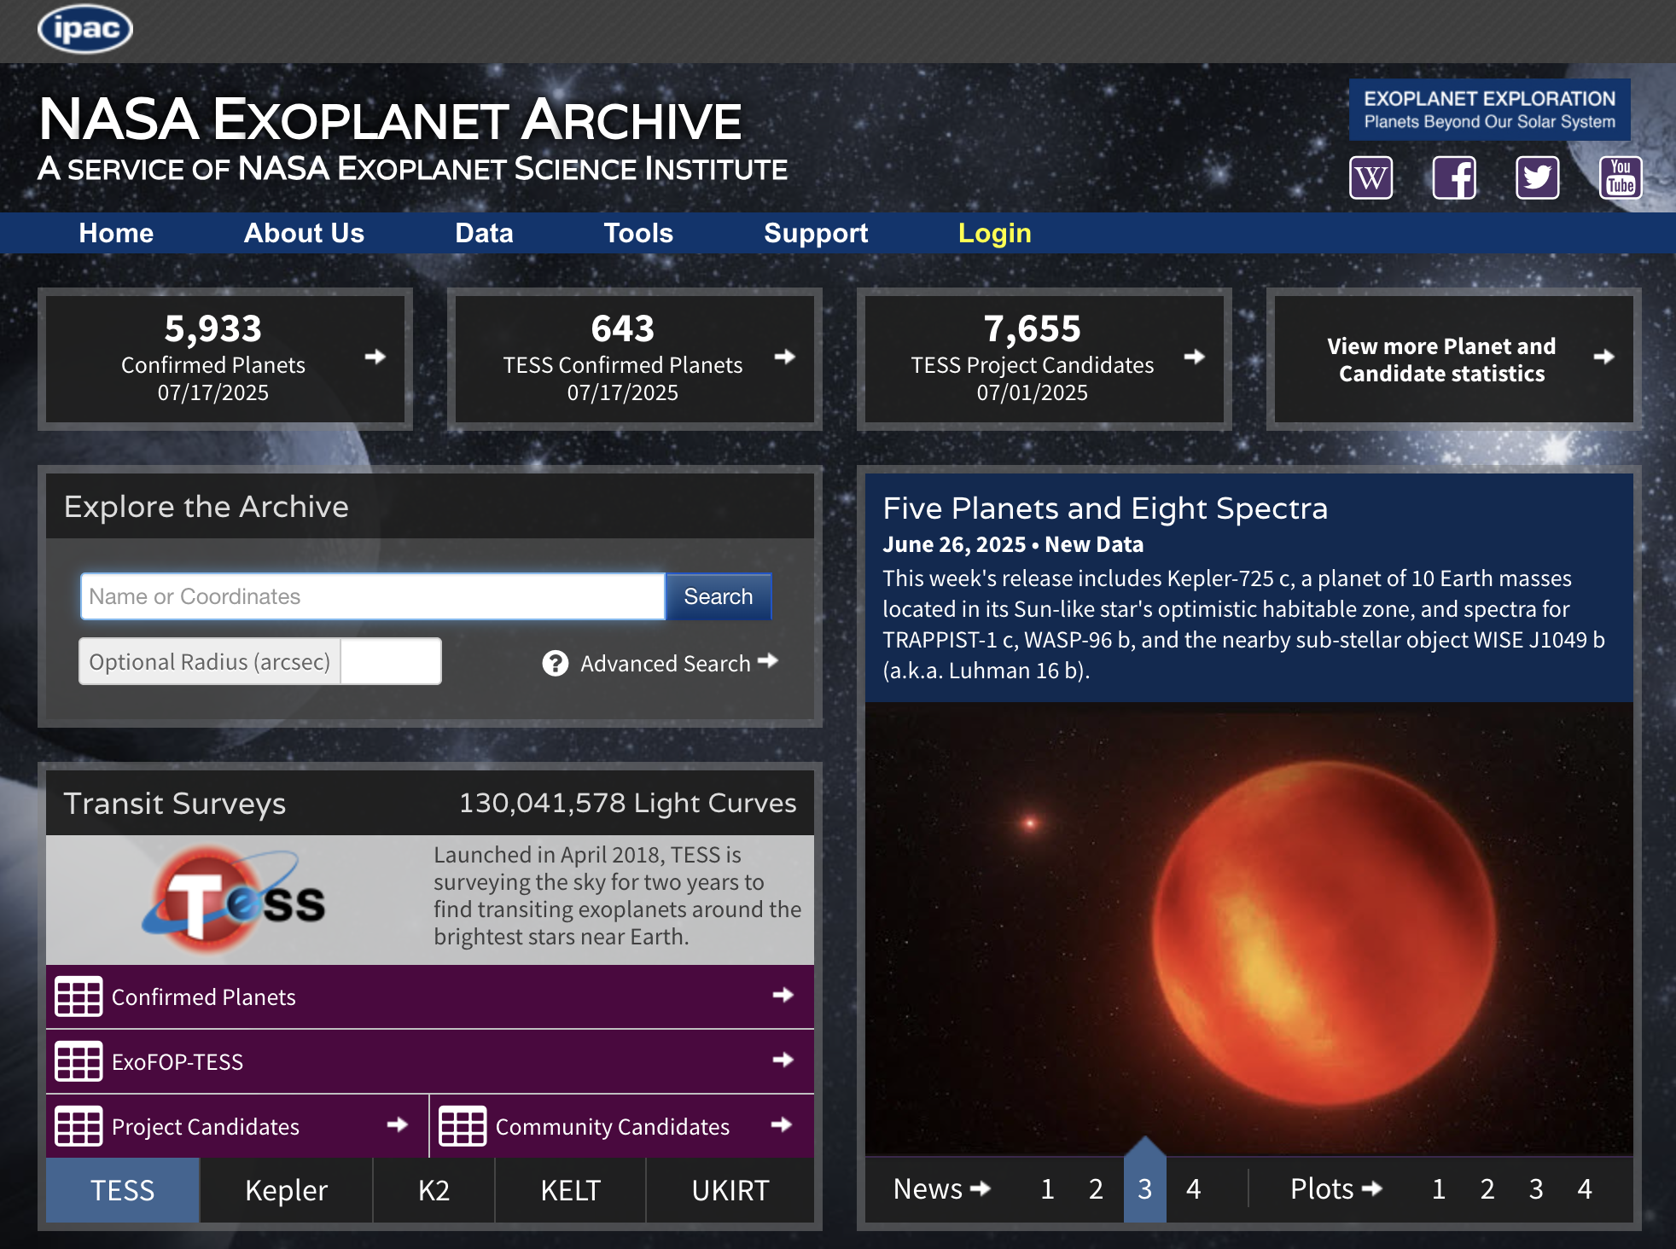
The problem is not that we don’t have enough data…

Slide 8
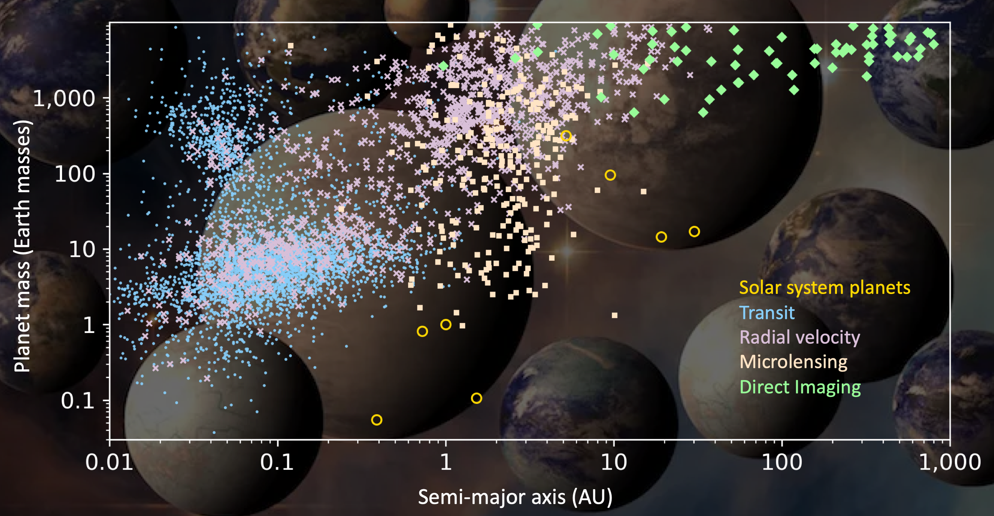
The problem is not that we don’t have enough data…

Slide 9
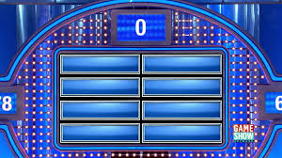
So what is the problem?
Why don’t we have fantastic demo-graphics yet?
Not enough meta-data!
Model/methodology differences/assumptions
Missing data, inc. provenance
Sample sizes
No selection criteria to cross-calibrate samples
No false positive/ negative rates
No detection criteria/ noise model provided
Calibration differences

Slide 10
03
Do’s
… in creating or evaluating a survey for demographics
(https://arxiv.org/pdf/2304.12442)

Slide 11
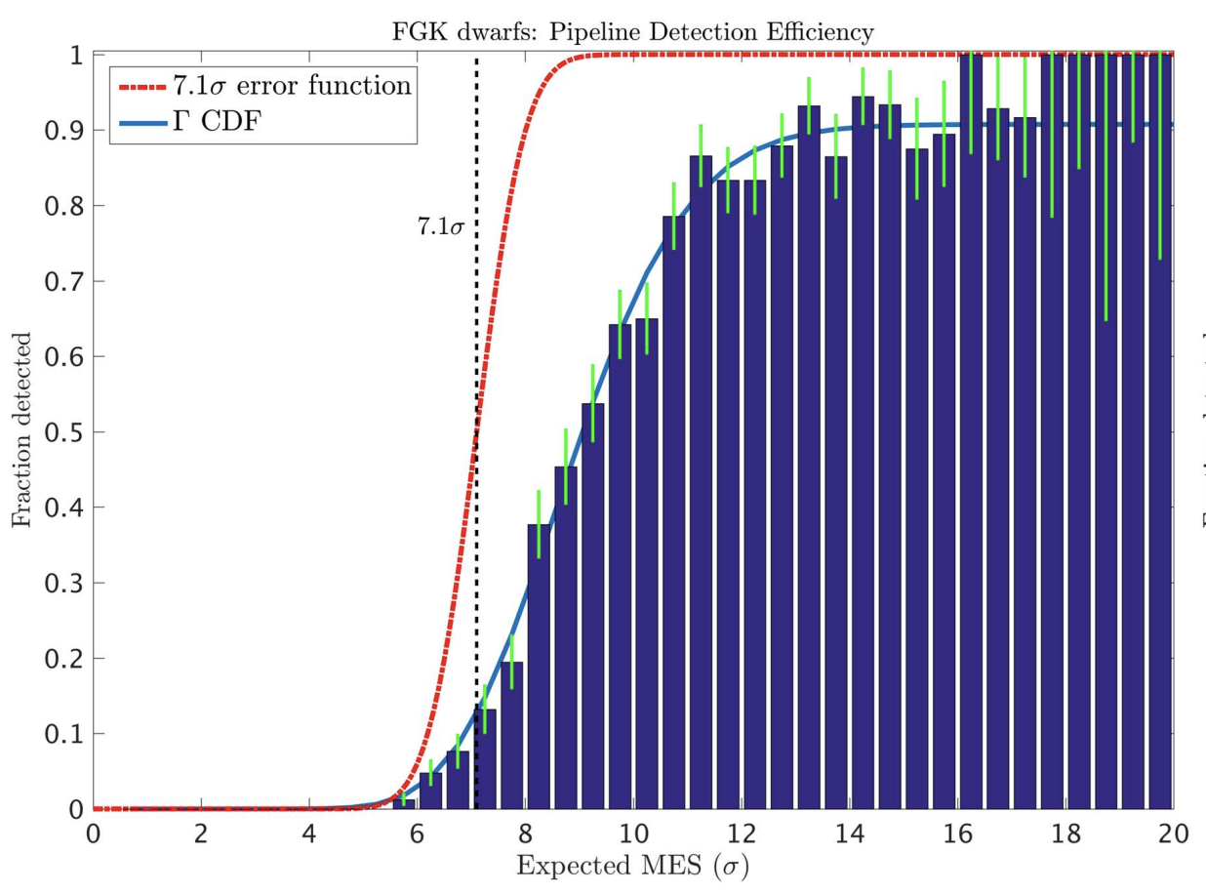
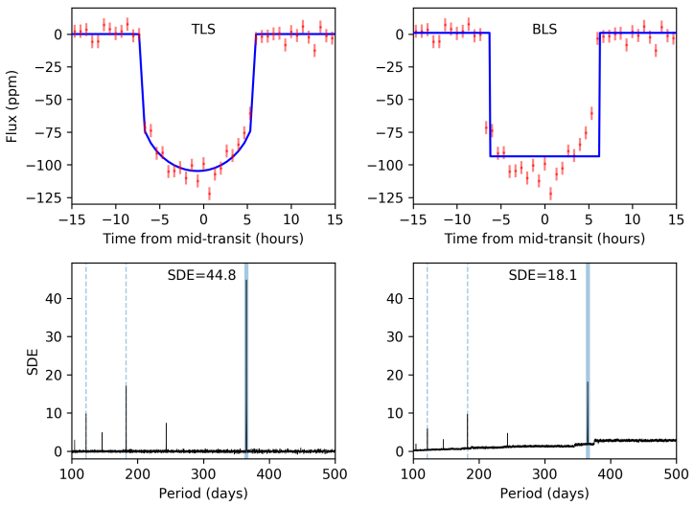
Does the survey have:
Survey properties | Stated detection criteria (e.g. SNR threshold, number of transits, etc?) Which models are being fit to the data? What is the observing baseline? Is it the same for every star or does it vary? A quantified method for handling binaries/multiple star systems? A DETECTION EFFICIENCY (false negative rate), and how is it measured?
Thompson+2018
https://github.com/hippke/tls

Slide 12
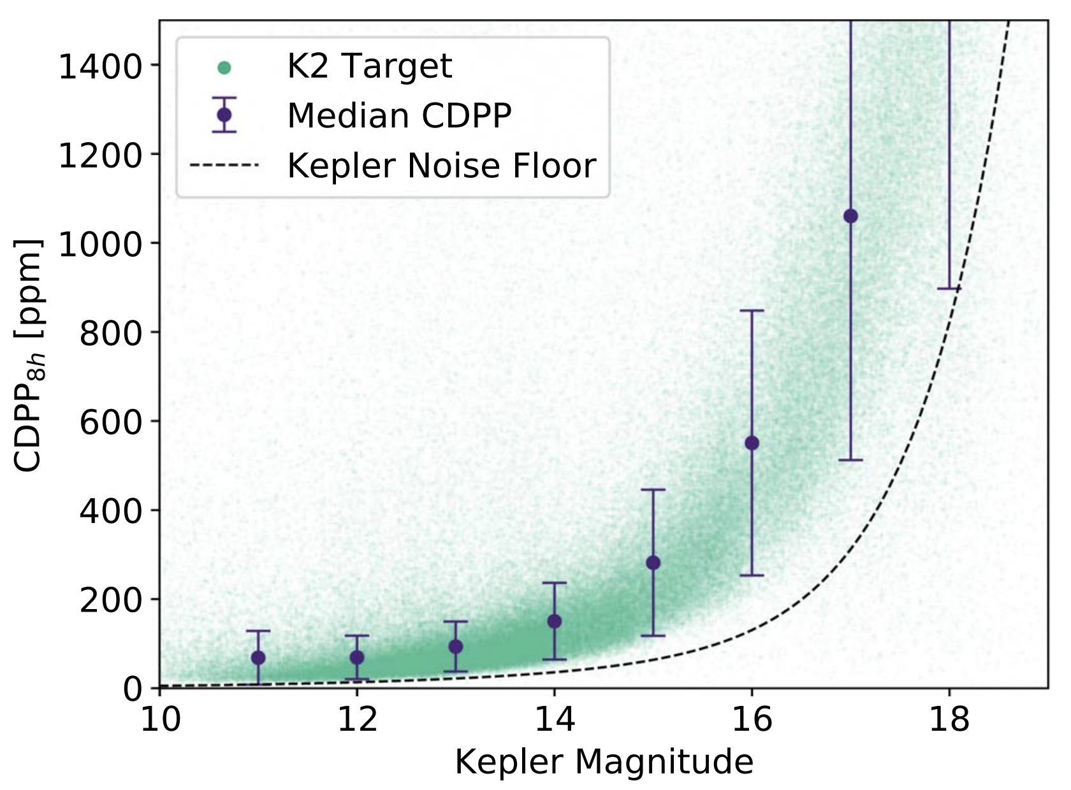
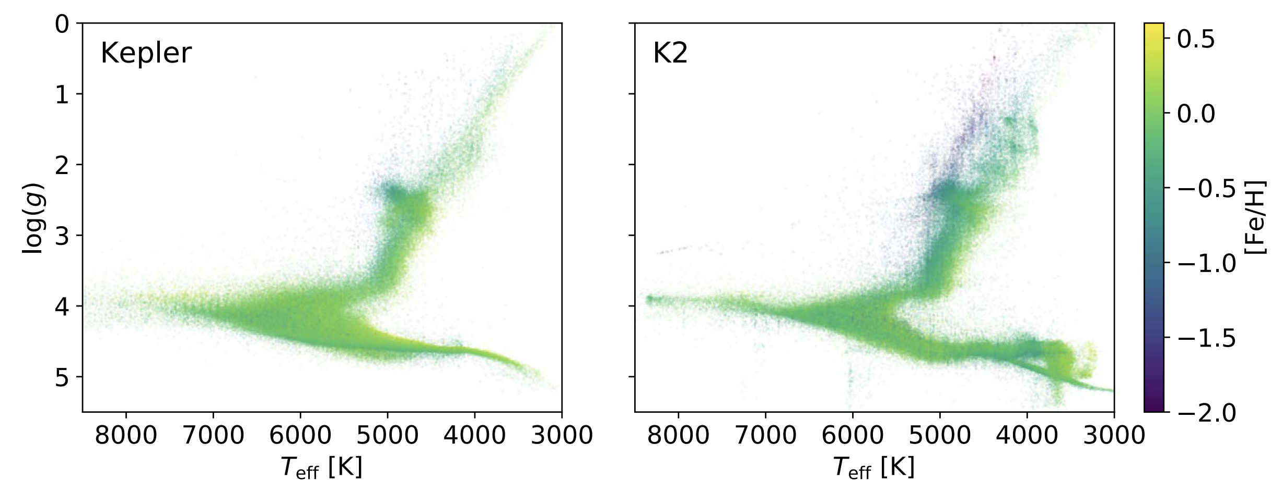
Does the survey have:
Stellar sample | A large enough sample of stars, and clear selection criteria for those stars? Which stellar parameters are used, and is their provenance UNIFORM? Which stars are removed from the final sample and why? Quantified noise properties for the stellar sample? IF this is the only data used, are there sufficient targets for your science?
Zink+2021

Slide 13
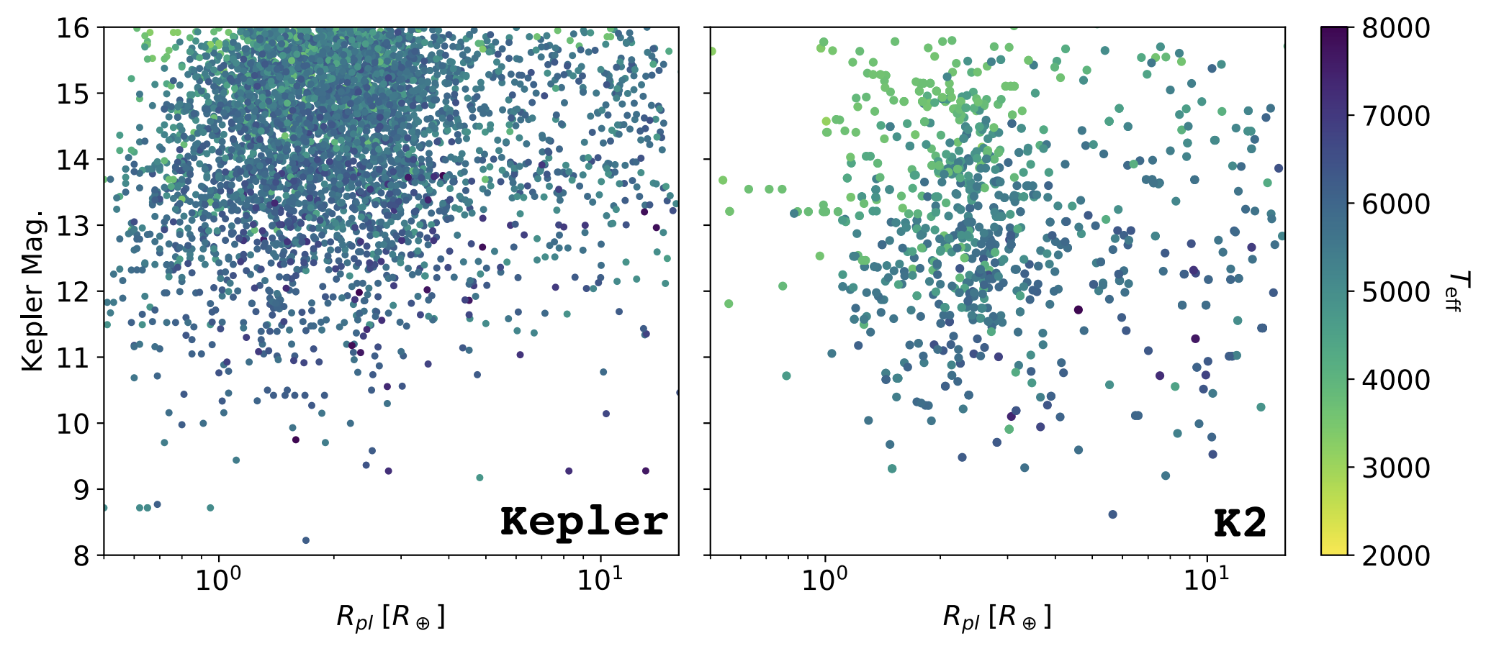
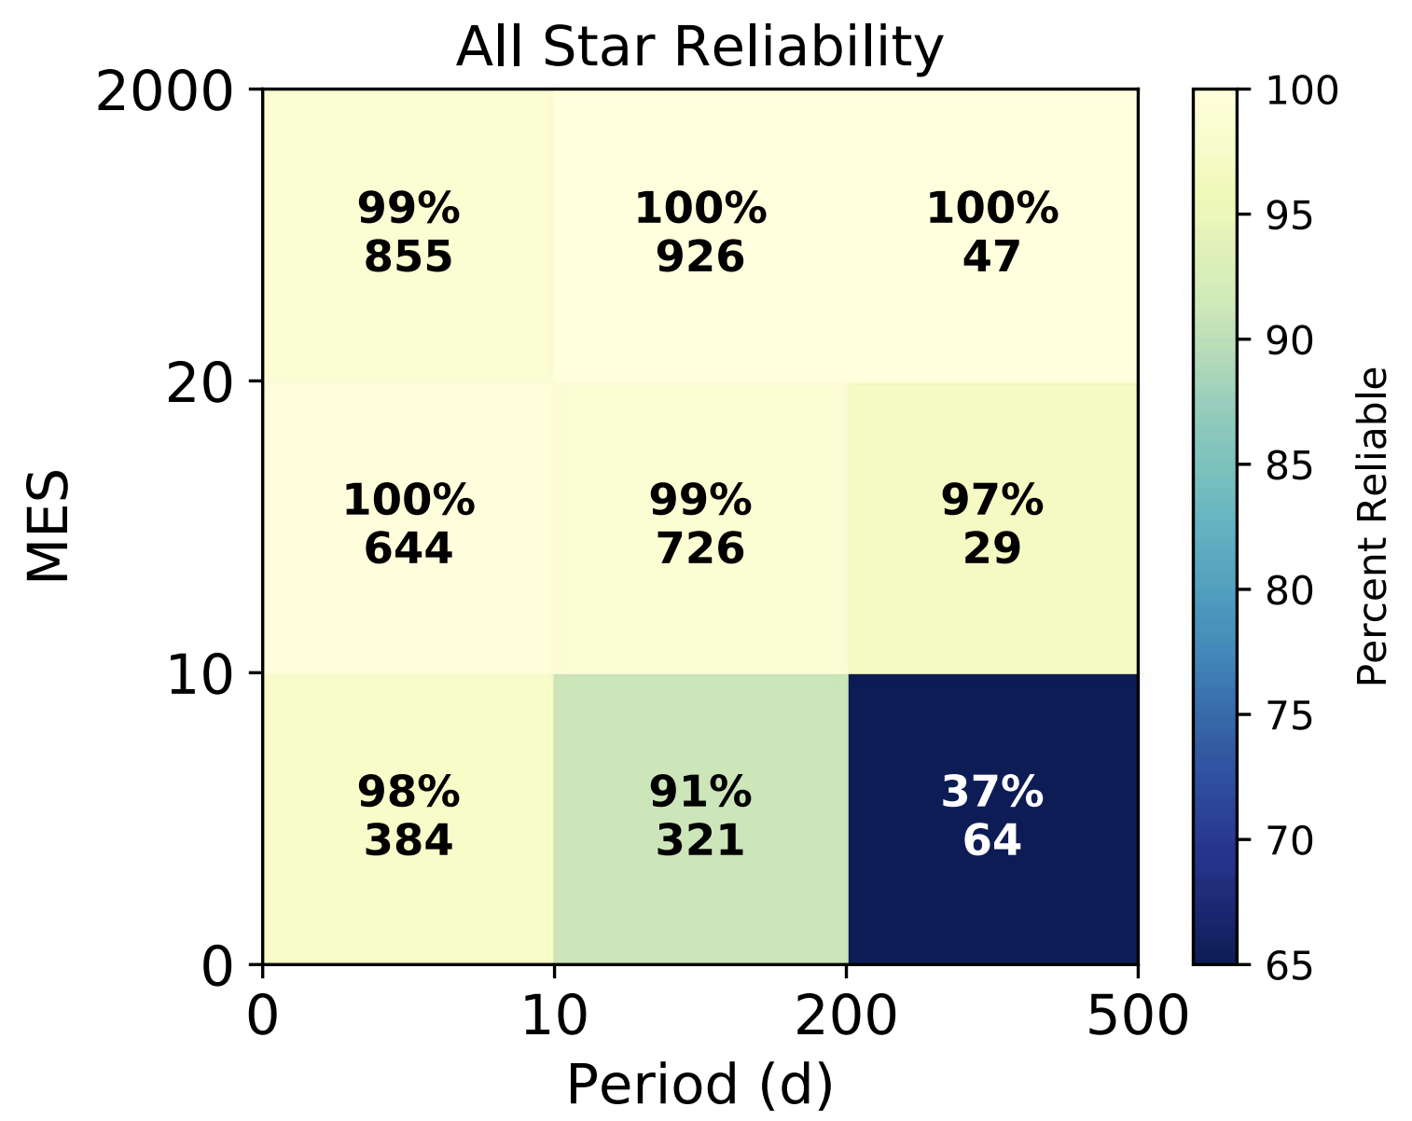
Does the survey have:
Planet catalog | Measured planet parameters, and how are they obtained? UNIFORMLY derived planet parameters, and what models are used? A catalog RELIABILITY? Is it measured or estimated? Does it include the astrophysical false positive and instrumental false alarm rates?
Zink+2021
Thompson+2018

Slide 14
Are the data FAIR?
Findable
Accessible
Interoperable
Reusable
Metadata and data should be easy to find for both humans and computers.
(Meta)data are retrievable by their identifier using a standard communications protocol; metadata are available, even when the data no longer are
(Meta)data use a formal, accessible, shared, and broadly applicable language for knowledge representation
Metadata and data should be well-described so that they can be replicated and/or combined in different settings, including a clear data usage license
https://www.go-fair.org/fair-principles/

Slide 15
04
DON’TS!
… in creating or evaluating a survey for demographics

Slide 16
NO
MANUAL
VETTING

Slide 17
DON’TS
… host the data on your institution’s server. The server will not outlast your survey’s usefulness!
… invent a new data format or standard for your data. An appropriate, open, free one already exists!
… assume you know all the use cases for your data. Provide (machine-readable!) meta-data to support a variety of use cases!
… throw data away without quantifying (and explaining) how/why!
… publish your detections and sit on your non-detections!
… your pet peeve here

Slide 18
05
Example
… in creating or evaluating a survey for demographics

Slide 19
Which planet catalog should I use for demographics?
Kepler
The NASA Exoplanet Archive
Survey properties | ✔️ | ❌
Stellar sample | ✔️ | ❌
Planet catalog | ✔️ | ❌

Slide 20
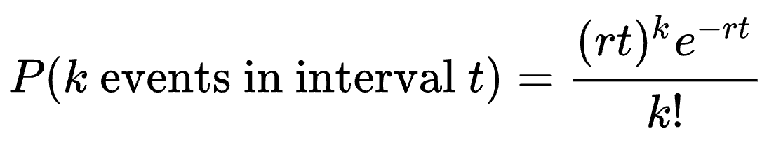
Example survey design
Searching for Habitable Exoplanets with Relative Astrometry (SHERA) | How many widely separated (20-200au) binary stars do we need to survey for small, habitable zone planets to determine whether the occurrence rate is similar to single stars? (Important input to planet formation physics, and how to prioritize binary stars with future missions like Habitable Worlds Observatory)
t = number of targets
k = number of planets detected
r = occurrence rate
t | 8 | 14
r | 0.46 | 0.46
k | 0 | 0
P | 0.025 | 0.001
Formulate your hypothesis, examine whether the survey can test it

Slide 21
06
Resources
… for creating or evaluating a survey for demographics

Slide 22
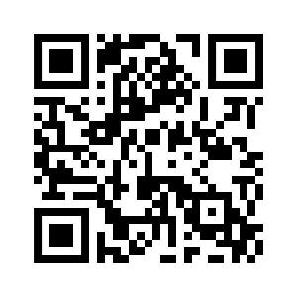
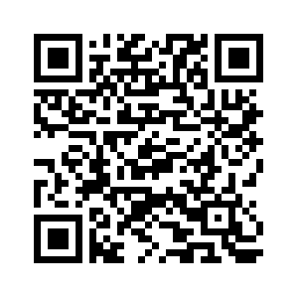
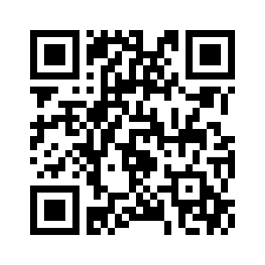
Resources
SIG#2 Report: Enabling Exoplanet Demographics Studies with Standardized Exoplanet Survey Meta-Data
Teske, Wang, Wolfgang et al. 2021;
Batalha, Wolfgang, Teske et al. 2023
NASA Exoplanet Archive Kepler Mission Page
https://www.go-fair.org/fair-principles/

Slide 23
Conclusions
No manual vetting!
Utilize metadata!
Please keep this slide for attribution

